Slide 1

17-3903
Apartment Building
Sketch Plan

Slide 2
Basics
49 unit apartment building
3-4 stories
Parking for 100 cars
Access off of Shadywood, lines up with the church access.

Slide 3
County supports access (includes a consolidation of the drive for the business center)
Density slightly higher than prescribed, but can be adjusted based on lot area
Hardcover will meet requirements

Slide 4
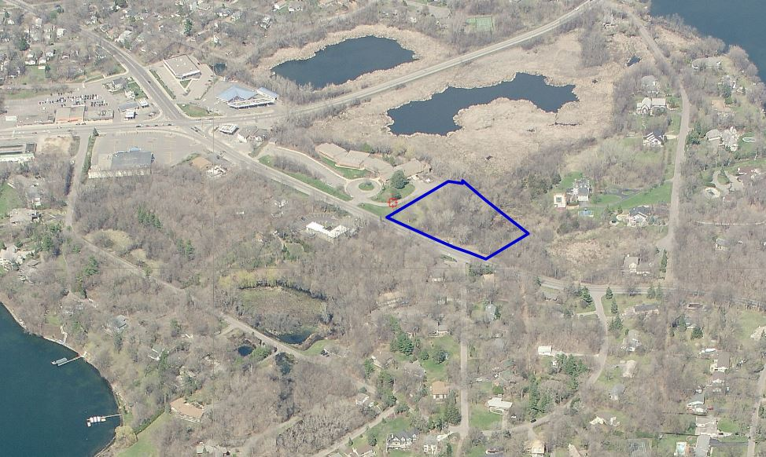

Slide 5
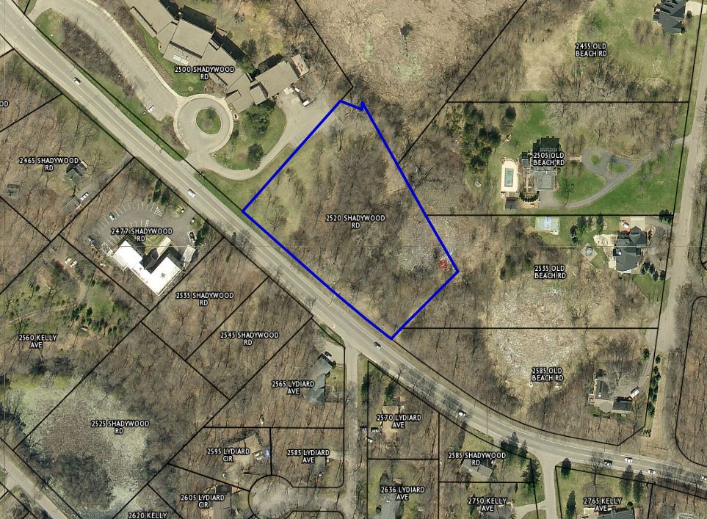

Slide 6
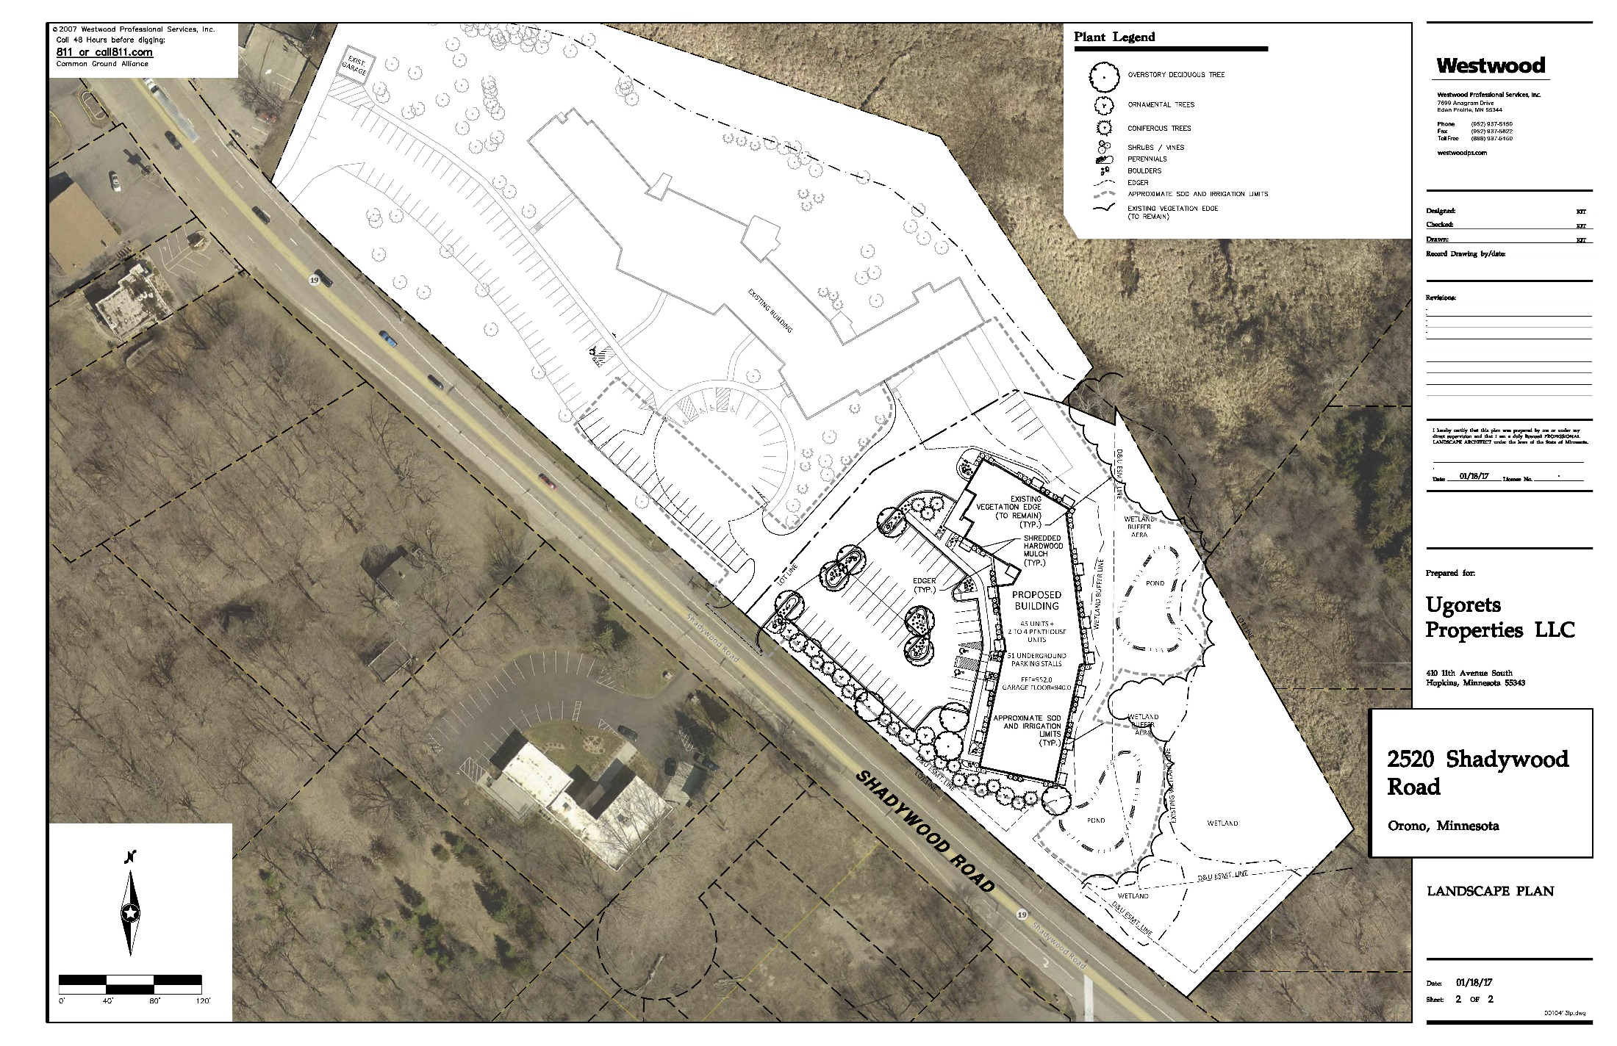

Slide 7
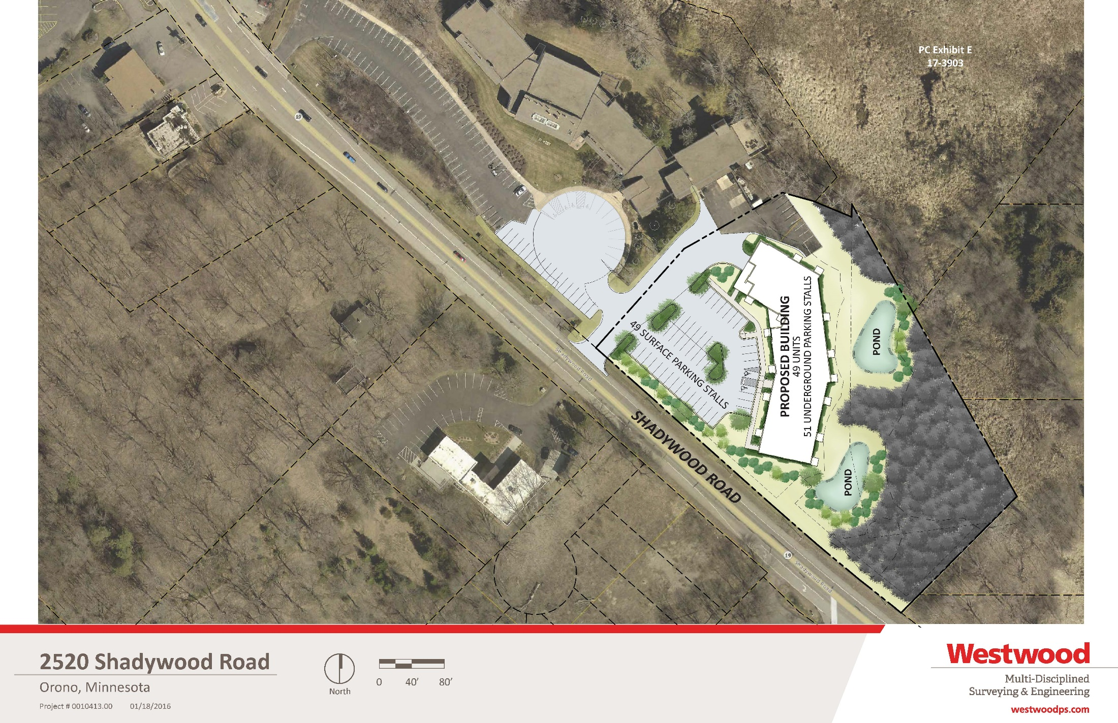

Slide 8
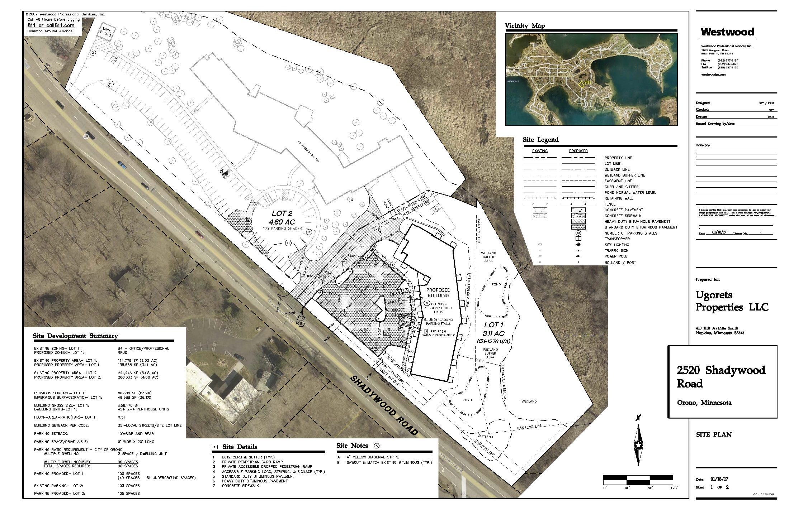

Slide 9
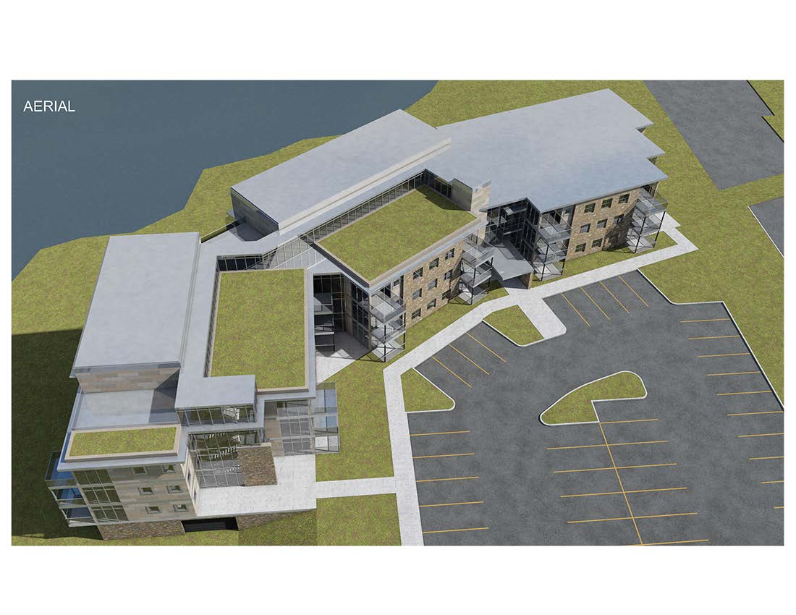

Slide 10
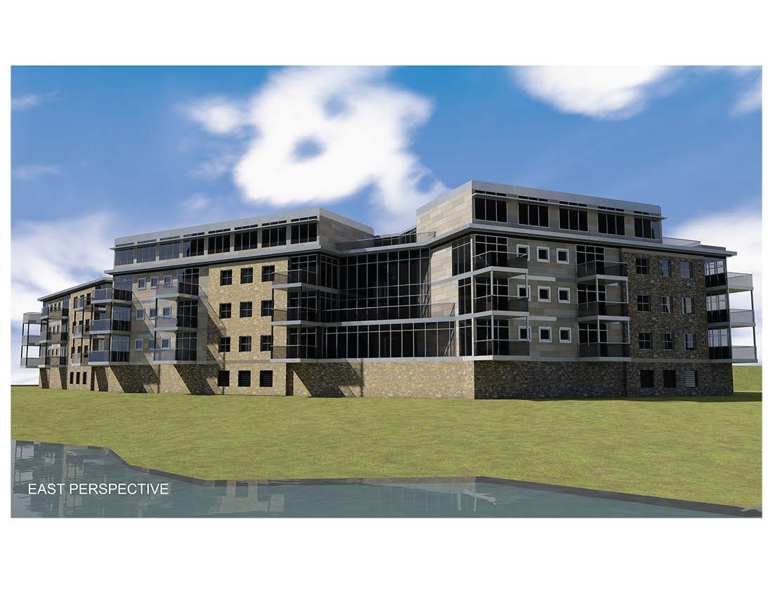

Slide 11
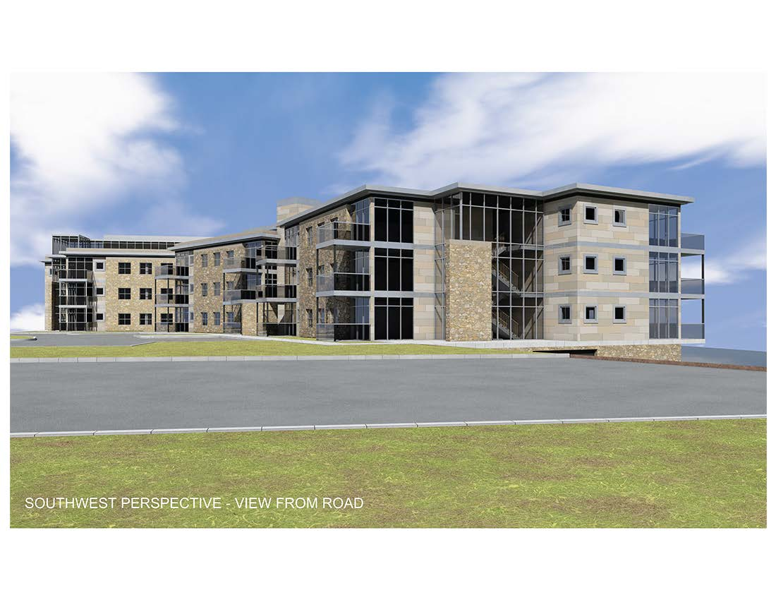

Slide 12
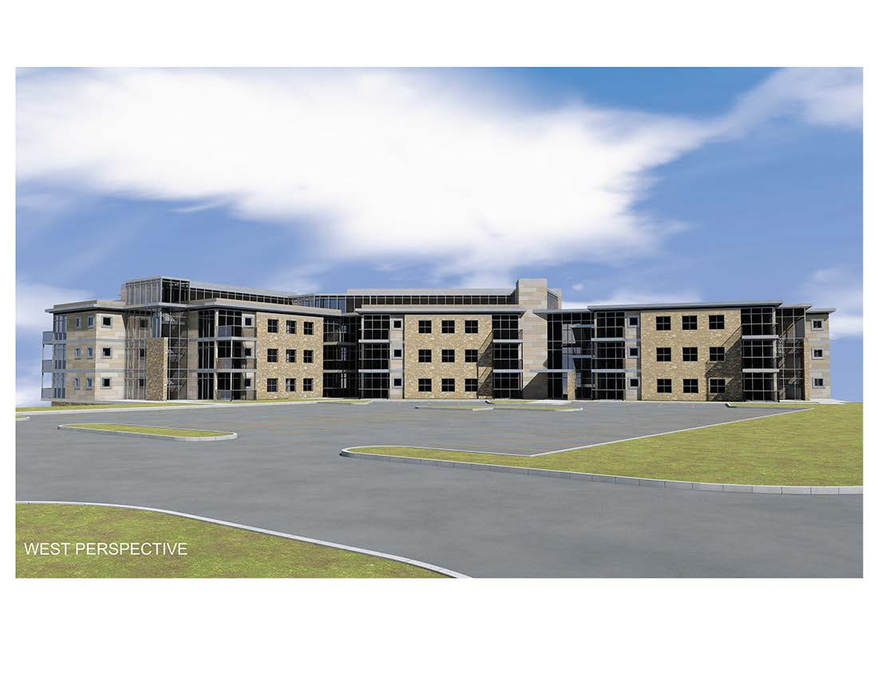

Slide 13
Commission Issues
Building height 3-4 stories from Shadywood
Density upper range of prescribed
Architecture Flat roof versus gabled?

