Slide 1
Orono Fire Department
November 12, 2024
Work Session

Slide 2

Mission Statement
The Mission of the Orono Fire Department is to expediently and professionally serve the needs of our Community with pride, dedication and excellence never failing to deliver quality emergency life safety services.
Vision Statement
Orono Fire will become the region’s top public safety organization through our commitment to excellence in all areas.
Our Values
Best – Do the best in everything you attempt
KnowlEdgeable – Never stop learning and training
InNovative - Don’t be afraid of new things or ideas
ServIce – over self, prioritizing our citizens, resident and communities
InClusive – we will work with our neighbors and partners without hesitation
IntEgrity – do what is right not what is easy

Slide 3
Incident type code description | # of Incidents
611 - Dispatched & canceled en route | 22
444 - Power line down | 15
554 - Assist invalid | 7
321 - EMS call, excluding vehicle accident with injury | 6
311 - Medical assist, assist EMS crew | 4
743 - Smoke detector activation, no fire - unintentional | 2
745 - Alarm system activation, no fire - unintentional | 2
320 - Emergency medical service incident, other | 2
736 - CO detector activation due to malfunction | 2
160 - Special outside fire, other | 2
733 - Smoke detector activation due to malfunction | 1
735 - Alarm system sounded due to malfunction | 1
111 - Building fire | 1
911 - Citizen complaint | 1
322 - Motor vehicle accident with injuries | 1
324 - Motor vehicle accident with no injuries. | 1
411 - Gasoline or other flammable liquid spill | 1
424 - Carbon monoxide incident | 1
445 - Arcing, shorted electrical equipment | 1
551 - Assist police or other governmental agency | 1
622 - No incident found on arrival at dispatch address | 1
651 - Smoke scare, odor of smoke | 1
700 - False alarm or false call, other | 1
Notes:
Total of 77 calls for service
About 30% of calls are EMS

Slide 4
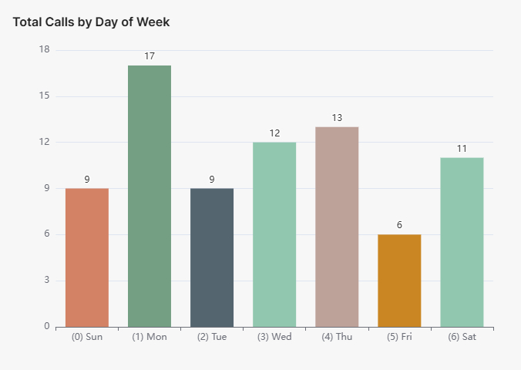

Slide 5
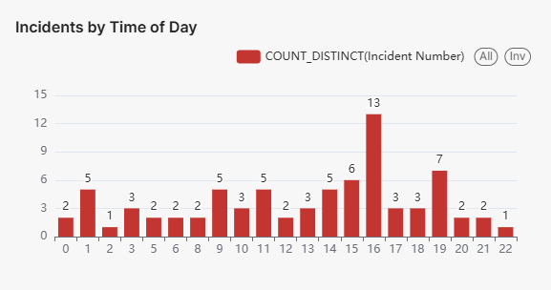
Notes:
82% of calls happen between the hours of 0600 to 2200, which is why we are staffing our DC during those hours
We try to move the DC to the call areas based on the busy times or when traffic is bad around the school
About 50% of our calls happen from 2-7pm

Slide 6
Response Time Goals and Actuals
Goals
Actuals
In service time an average of:
  60 seconds for medicals and
  80 seconds for fire calls
  Source: NFPA 1710
On scene time of:
  10 minutes or less 80% of the time
  Source: NFPA 1720
Inservice time for all of the calls:
  90 seconds average
  76 seconds median
On scene time:
  11:31 seconds or less 80% of the time.
  9:40 Average
  9:26 Median
Notes:
This is for all of our calls for service. We are trying to designate out just our response with lights and sirens.

Slide 7
Orono Fire Department Duties
Plan for on-scene responses.
  We are using the data to date to determine when and where our Duty Crew should be located for response
Ensure fire code enforcement.
  We are the beginning stages of routine fire code inspections
  We perform plan reviews on all new commercial and residential developments to ensure fire code enforcement.
  Review burn and event permits
Prepare a competent work force and support safe operations.
  We assign online training that can be done on shift of at home
  We assign shift training for our firefighters
  We have in-person group training on Wednesday nights

Slide 8
Orono Fire Department Goals
Plan for on-scene responses.
  Our goal is to do 4 pre-plans per week
Ensure fire code enforcement.
  We are the beginning stages of routine fire code inspections
  Our goal is to do 4 inspections for fire code enforcement per week
Prepare a competent work force and support safe operations.
  Goal is to do one of each of the following per month Blue Card CE module , FRSI module and Brass Tacks & Hard Facts module for our online training that can be done on shift of at home
  Quarterly EMS training
  2 – 4 in-person group training on Wednesday nights per month
Notes:
16 done

Slide 9
Community Engagement
Promote public awareness of fire safety.
Orono Fire Open House
Halloween at the Stables
Orono High School Leadership Class Guest Speaker
Orono School Auction – Ride to School with the Duty Crew and Chief
Orono Public Works Open House
Navarre Lunds and Byerlys Boo Blast
Salvation Army Bell Ringing at the Navarre Lunds and Byerlys
Orono Tree Lighting
Navarre Business Pre-planning with Duty Crews
Popup Meet and Greets at Areas in Navarre
Orono Health and Wellness Fair
Orono Schools Heart Safe Event
Culver’s Heart Safe Event
Stonebay Heart Safe Event

