Slide 1



Orono Police Department
Work Session

Slide 2
2024 Calls for Service
2024 Call for Service
01/01/24 to 11/5/24
City Crime Summary Report
Mound 1179
MTB 68
Orono 1038
SP 273
All 2558
Same time frame for 2023 was total 3177.
Calls for service 15,495 14,695 (2023)

Slide 3


Day of Week | 1 | 2 | 3 | 4 | Total
Sunday | 746 | 68 | 950 | 166 | 1930
Monday | 869 | 93 | 834 | 246 | 2042
Tuesday | 818 | 101 | 944 | 279 | 2142
Wednesday | 968 | 65 | 979 | 231 | 2243
Thursday | 898 | 89 | 1011 | 268 | 2266
Friday | 983 | 108 | 1111 | 302 | 2504
Saturday | 912 | 91 | 1206 | 159 | 2368
Total | 6194 | 615 | 7035 | 1651 | 15495

Slide 4
Time Of Day | 1 | 2 | 3 | 4 | Total
00:00:00 - 00:59:59 | 203 | 39 | 171 | 16 | 429
01:00:00 - 01:59:59 | 138 | 30 | 128 | 14 | 310
02:00:00 - 02:59:59 | 67 | 31 | 176 | 12 | 286
03:00:00 - 03:59:59 | 59 | 27 | 110 | 5 | 201
04:00:00 - 04:59:59 | 55 | 10 | 106 | 9 | 180
05:00:00 - 05:59:59 | 70 | 5 | 83 | 11 | 169
06:00:00 - 06:59:59 | 151 | 7 | 111 | 12 | 281
07:00:00 - 07:59:59 | 210 | 7 | 217 | 48 | 482
08:00:00 - 08:59:59 | 274 | 16 | 381 | 96 | 767
09:00:00 - 09:59:59 | 275 | 27 | 388 | 131 | 821
10:00:00 - 10:59:59 | 288 | 27 | 389 | 143 | 847
11:00:00 - 11:59:59 | 253 | 24 | 395 | 140 | 812
12:00:00 - 12:59:59 | 193 | 15 | 352 | 104 | 664
13:00:00 - 13:59:59 | 257 | 22 | 445 | 143 | 867
14:00:00 - 14:59:59 | 277 | 30 | 424 | 142 | 873
15:00:00 - 15:59:59 | 405 | 26 | 415 | 128 | 974
16:00:00 - 16:59:59 | 426 | 29 | 439 | 97 | 991
17:00:00 - 17:59:59 | 341 | 27 | 431 | 88 | 887
18:00:00 - 18:59:59 | 349 | 34 | 380 | 73 | 836
19:00:00 - 19:59:59 | 479 | 40 | 370 | 67 | 956
20:00:00 - 20:59:59 | 426 | 42 | 331 | 60 | 859
21:00:00 - 21:59:59 | 377 | 32 | 279 | 57 | 745
22:00:00 - 22:59:59 | 358 | 31 | 278 | 37 | 704
23:00:00 - 23:59:59 | 263 | 37 | 236 | 18 | 554
Total | 6194 | 615 | 7035 | 1651 | 15495

Slide 5
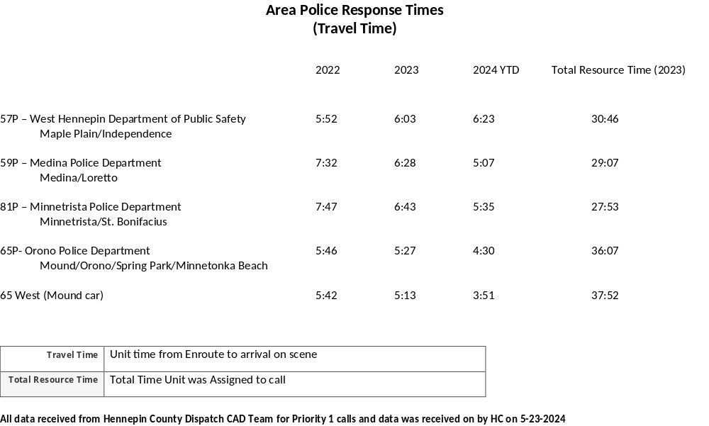

Slide 6
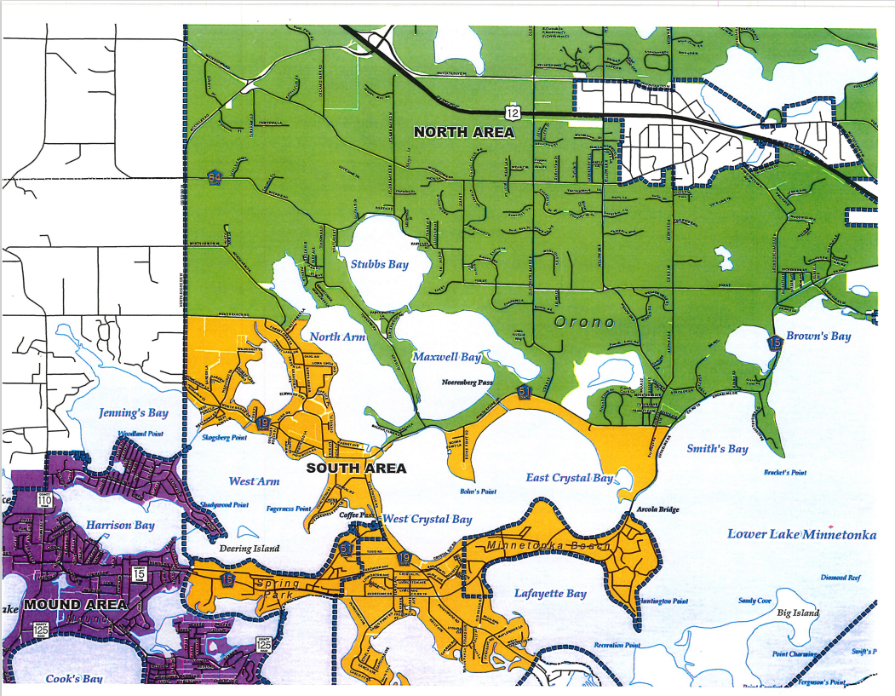

Slide 7
Community Engagement
Creative Kids Family Day Event
Spirit of the Lakes
Minnetonka Beach Kids Parade
Mound Fish Fry
Orono Trap Shoot
Orono Woods Coffee with a Cop
Orono School District Recognized SRO for his 4 Years of Service
Music in the Park Attendance for Kids
Orono Public Works Open House
DARE Open in Waconia
MPLS Officer recognition by the Twins Organization – Attended Representing Orono’s Support
Orono School Auction – Ride to School with the Chief
Rotary’s Trash Clean-Up
Orono Kindergarten Visit/Tour of Orono PD
Orono Schools Forensics Day at Orono PD
Orono PD attended OLL Track and Field Day for Youth
OLL Bike Rodeo
Calvin Church Community Meals
Orono PD Attended Glow Fest at the Orono Schools
OLL Heart Safe Assistance
OLL DARE Graduation
Orono Scouts Toured Orono PD along with a Short Presentation on Respect
Orono Clean Up Days / Drug Take Back
Halloween Parties
Explorers recognized for their Outstanding Rochester Conference
Three officers Completed IPIMBA Training (bike school)
Thank You to Spring Park for a Portion of Their Public Safety Dollars (funding K9, Body Bunkers, 40M Non-Lethal Equipment)

Slide 8
Investigative Summary
January through November 5, 2024
236 Investigative cases
173 Department arrests
18 Death investigations
2 Referred vulnerable adult cases from patrol and/or Hennepin
County Adult Protection
95 Handgun permit to purchase applications
2 Handgun permit to purchase applications denied
78 Theft cases
45 Fraud/Forgery cases
4 Motor Vehicle Theft cases
8 Burglary cases
0 Robbery
0 Arson cases
39 Assaults, including domestic assault
11 Crim sex reported offenses (includes CSC and exposure)
0 CVO (Injuries only)
0 Homicide
121 Referrals to Embedded Social Worker

Slide 9
WMDTF Summary 2024
  169 Arrests
  247 Search warrants
  60 Firearms plus 1 suppressor
  1,988 grams heroin/fentanyl plus 5,327 pills
  32,134 grams THC edibles/ by products
  3,200 grams THC Oil and wax
  11,665 Vape Cartridges
  70,670 grams marijuana
  32,111 grams methamphetamine
  5,297 grams cocaine
  3,263 grams psilocybin mushrooms
  3,510 prescription pills
SWMDT joined WMDTF as of 1/1/24 VCET

