Slide 1
Orono Fire
Creating a Culture of Excellence
James Van Eyll
Orono Fire Chief

Slide 2
Incidents from Sept 19 – Oct 25
INCIDENT NUMBER | ALARM DATE | INCIDENT LOCATION | INCIDENT TYPE | DISPATCH TIME | EN ROUTE TIME | ON-SCENE TIME | UNIT | NOTES
OFD-2024-00061 | 09/17/24 | 1500 Block Orchard Beach Place | Lift Ast | 21:39:39 | 21:41:00 | 21:52:48 | Duty Crew | Routine Response
OFD-2024-00062 | 09/21/24 | Luce Line Trail GPS Coordinates | Medical | 19:26:17 | 19:26:17 | 19:33:57 | Duty Crew
OFD-2024-00063 | 09/23/24 | 3400 Block Shoreline Dr | Medical | 11:56:18 | 11:56:27 | 12:03:33 | Duty Crew
OFD-2024-00064 | 09/26/24 | 70 Block North Shore Drive | Fire Alarm | 5:37:19 |  |  | Duty Officer | Cancelled
OFD-2024-00066 | 10/03/24 | 3500 Block Ivy Place | CO Alarm | 9:44:00 | 9:45:37 |  | Duty Crew | Cancelled
OFD-2024-00067 | 10/09/24 | 3500 Block Kelly Parkway | Fire Alarm | 10:45:11 | 10:45:52 | 10:54:16 | Chief 1 | Cancelled when arrived on scene
OFD-2024-00069 | 10/14/24 | 3900 Block Dahl Rd | Fire Alarm | 16:57:28 | 16:58:04 |  | Duty Crew | Cancelled
OFD-2024-00070 | 10/14/24 | 2500 Block Casco Point Road | Fire Alarm | 19:04:52 | 19:05:41 |  | Duty Crew | Cancelled
OFD-2024-00071 | 10/15/24 | 400 Block Tonkawa Road | Fire Alarm | 11:54:40 | 11:55:19 |  | Duty Crew | Cancelled
OFD-2024-00072 | 10/22/24 | 3400 Block Livingston Ave | Garage Fire | 15:46:05 | 15:47:37 | 15:51:06 | All Call
OFD-2024-00073 | 10/23/24 | 3700 Block Livingston Ave | Lift Ast | 5:42:09 | 5:43:25 | 5:53:31 | Duty Officer | Routine Response
OFD-2024-00074 | 10/24/24 | 2200 Block Shadywood Rd | Medical | 1:47:35 | 1:49:52 | 1:55:25 | Duty Officer
OFD-2024-00075 | 10/24/24 | 4600 block West Branch Rd | Accident | 15:00:36 | 15:02:09 | 15:12:11 | Duty Crew

Slide 3
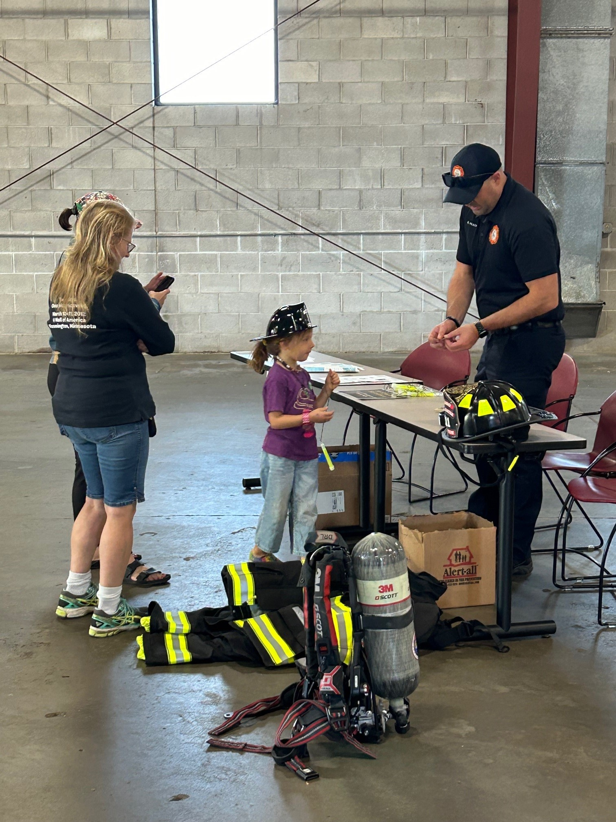
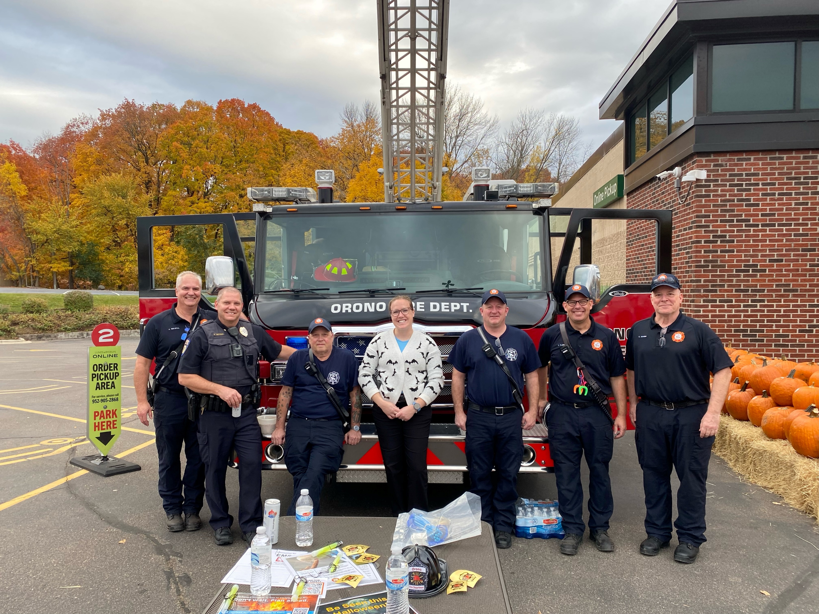
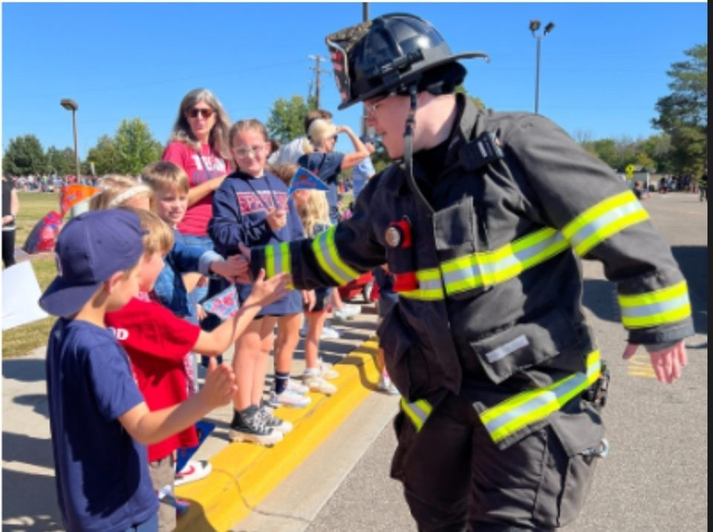
Community Engagement
Orono Fire and Orono PD at Boo Blast
Homecoming Parade
Open House
Notes:
We will be at Boo Blast

Slide 4
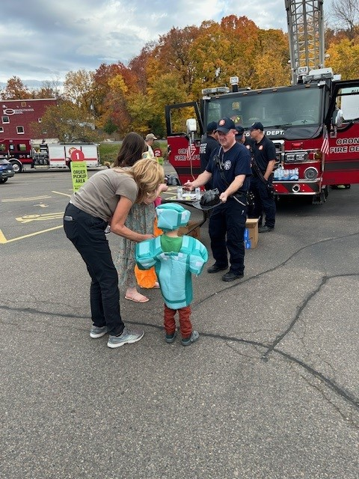
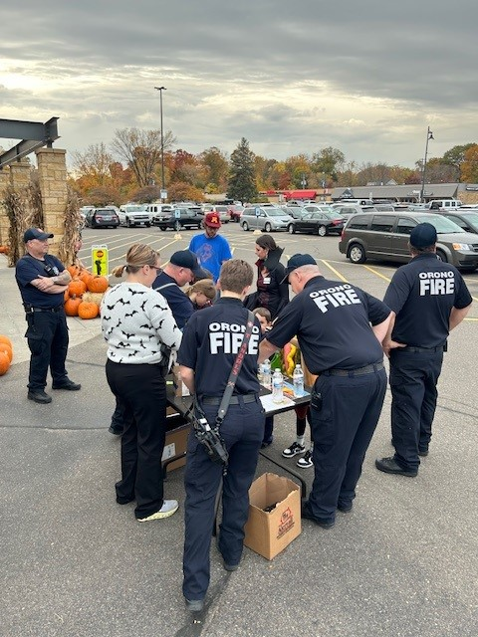
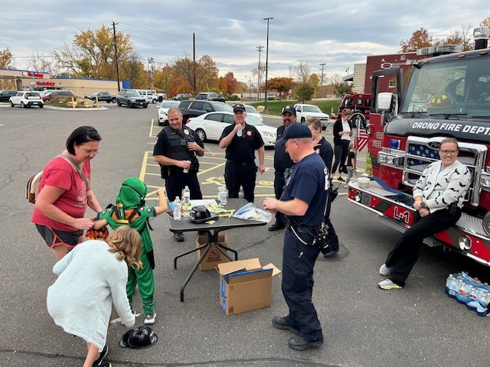
Boo Blast
Orono Fire and Orono PD at Boo Blast
Notes:
We will be at Boo Blast

Slide 5


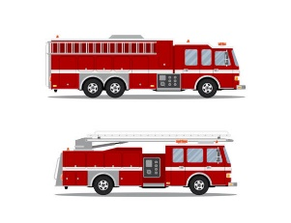
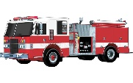
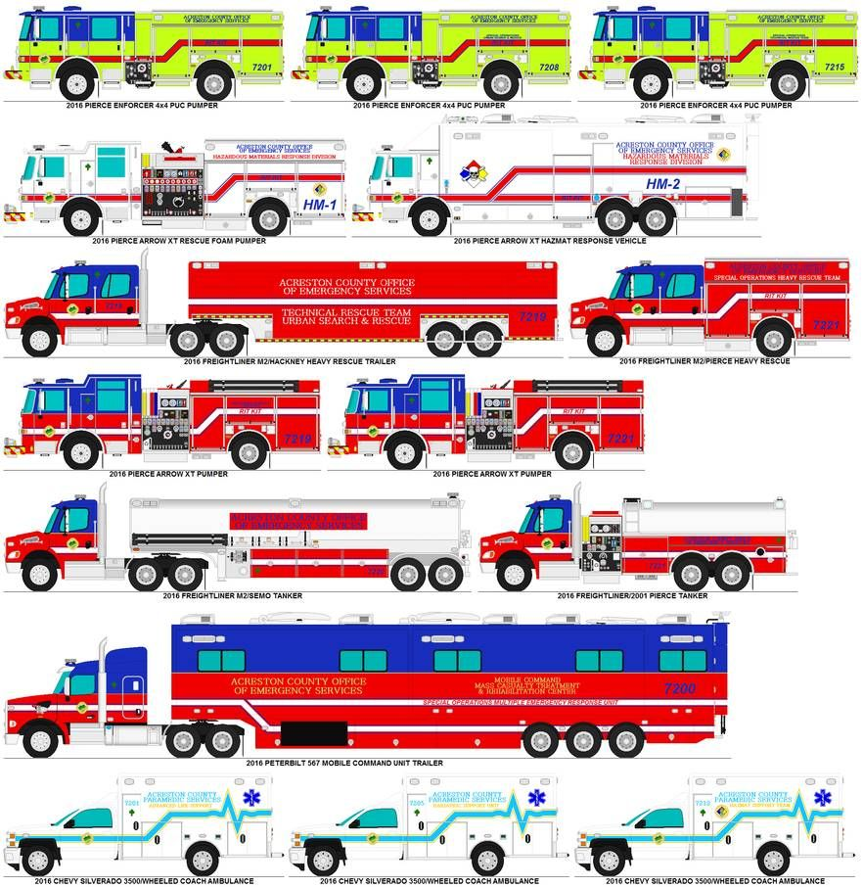
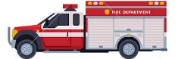


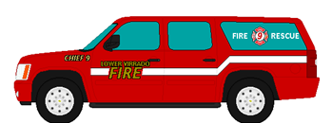
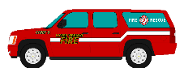
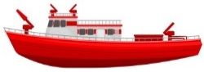
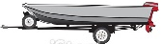
Orono Fire Department Stand up Status As of: _ October 28, 2024 _
To Service Navarre Area -- July 1, 2024
To Service Northern Orono -- January 1, 2026
Personnel
Full Time
Part Time
“Career”
Paid on Call “Volunteer”
Equipment
&
Facilities
Old Public Works
Navarre Station
“Station 2”
Navarre Garage
Willow Station
“Station 1”
Training
Individual Training
Crew Training
Individual Training
Crew Training
74% EMT or Higher
25% EMR
96% FF1
96% FF2
70% Engineer/FAO
48% Ladder
48% Draft
39% BlueCard IC
Started in April
EMT
EMR
FF1
FF2
Engineer
Ladder
Draft
BlueCard IC
Administration
Organization Model
Budget
☑ Capital Improvement Plan
☑ Job Descriptions
☑ Fire #
☑ Mutual Aid Agreement
☑ Dispatch Agreement
☑ Policy Manual
Scheduling system
Relief by Laws
Relief Art. Incorp.
Specialty Pay
Stn 1 Co use Agreement
Mission Vision Values Statements
RMS software
Pre-plan software
Inspection software
Training software
Notes:
We following best practices and national guidelines for response standards
We have 2 more PT FF applications and one PT FF moving through the process
We average 9 years experience per FF

