Slide 1
City of Orono
3rd Quarter 2024
Financial Update

Slide 2
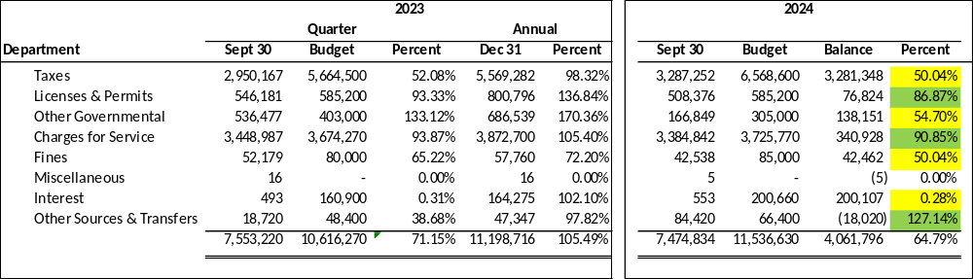
City of Orono
General Fund Revenue

Slide 3
City of Orono
General Fund Revenue Comparison

Slide 4
City of Orono
Building Permit Revenue

Slide 5
City of Orono
Building Permit Revenue with YTD
Budget = $565,000

Slide 6
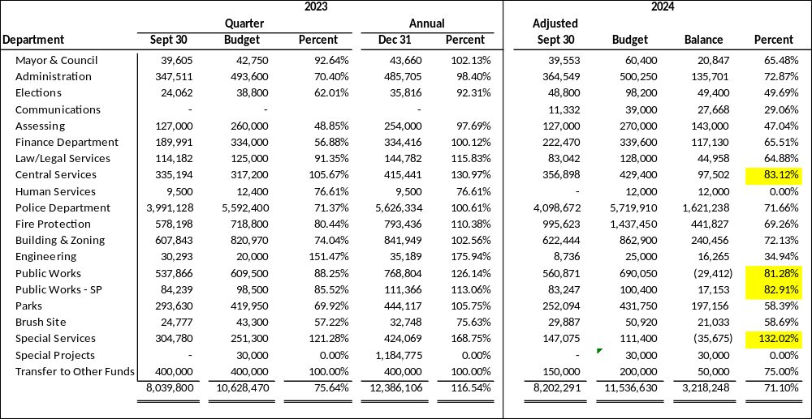
City of Orono
General Fund Expenditures

Slide 7
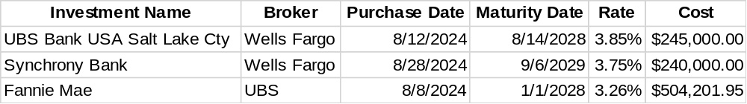
New Investments

Slide 8
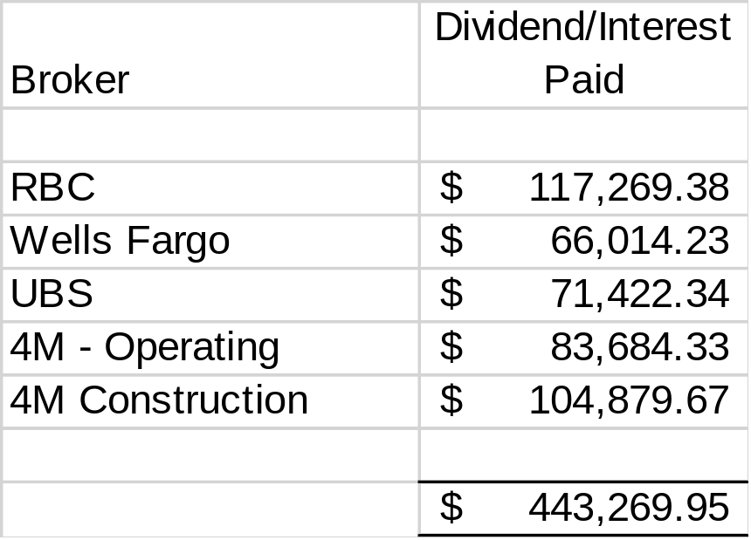
2024 Interest Earned

