Slide 1
Draft
Capital Improvement Plan
2025
October 28, 2024

Slide 2
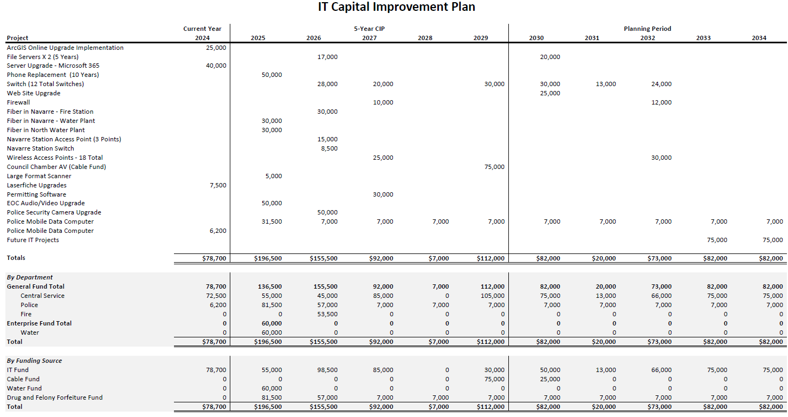

Slide 3
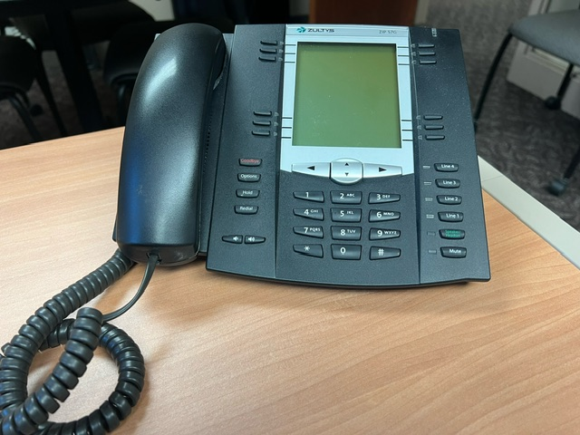
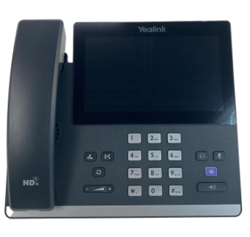
Equipment: Phone Replacement
CIP Section: IT
Description: The replacement of City phones.
Analysis of Need/Justification: The phones that city staff uses are currently over a decade old. Screens are fading and phones are incompatible with new capabilities, such as Microsoft Teams. Microsoft Teams will give us the capability of answering our desktop phones from anywhere.
Alternatives: Keep using current phones. Some of the phones are no longer able to work, will have to purchase a replacements of some sorts when this occurs anyways.
Budget Estimate:
Funding: To be funded from IT Fund.
Current Phones
Item | Estimate
Phone Replacement | $ 50,000
TOTAL | $ 50,000
New Phone Option

Slide 4

Project: Fiber – Navarre/North Water Plants
CIP Section: IT
Description: Install of fiber to Navarre and North Water Plants.
Analysis of Need/Justification: Faster internet connection, this would increase our speed from 100 Mbps to 100 Gbps and eliminate having to bounce a radio signal across the cities to each plant. The radio wave technology is less reliable and becoming extinct.
Alternatives: Keeping the antiquated system we have now isn’t a reliable option.
Budget Estimate:
Funding: To be funded from IT Fund.
Item | Estimate
North Water Plant | $ 30,000
Navarre Water Plant | $ 30,000
TOTAL | $ 60,000

Slide 5
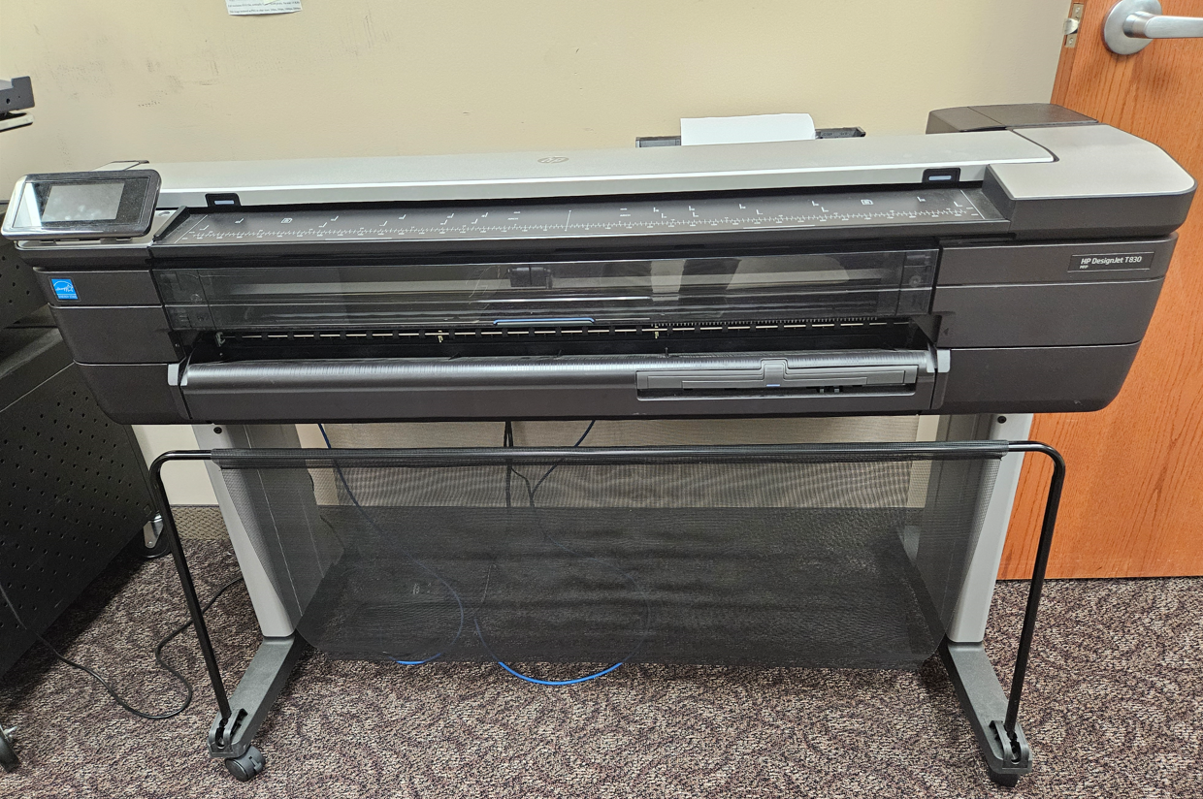
Equipment: Large Format Printer/Scanner
CIP Section: IT
Description: The purchase of an new large format printer/scanner.
Justification: The large format scanner we have now is getting outdated (over 7 years old).
Advantages:
Allows us to print on a larger scale and make an impact while still maintaining high resolution and clarity.
The ability to scan large prints into our file server.
Being able to print out maps and drawings for meetings and presentations.
Higher quality printing.
Budget Estimate:
Funding: To be funded from IT Fund.
Item | Estimate
HP DesignJet Printer/Scanner | $ 5,000
TOTAL | $ 5,000
Old Large Format Printer

Slide 6
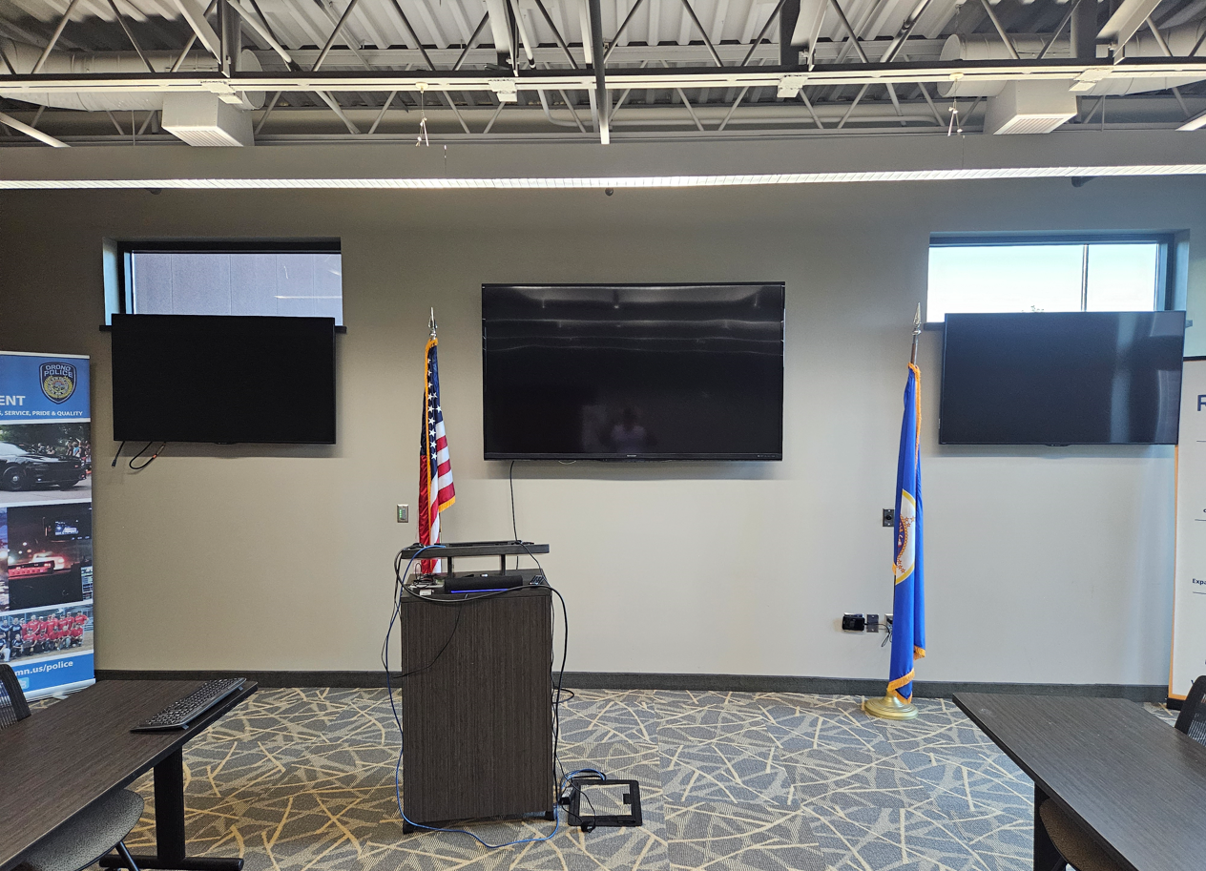
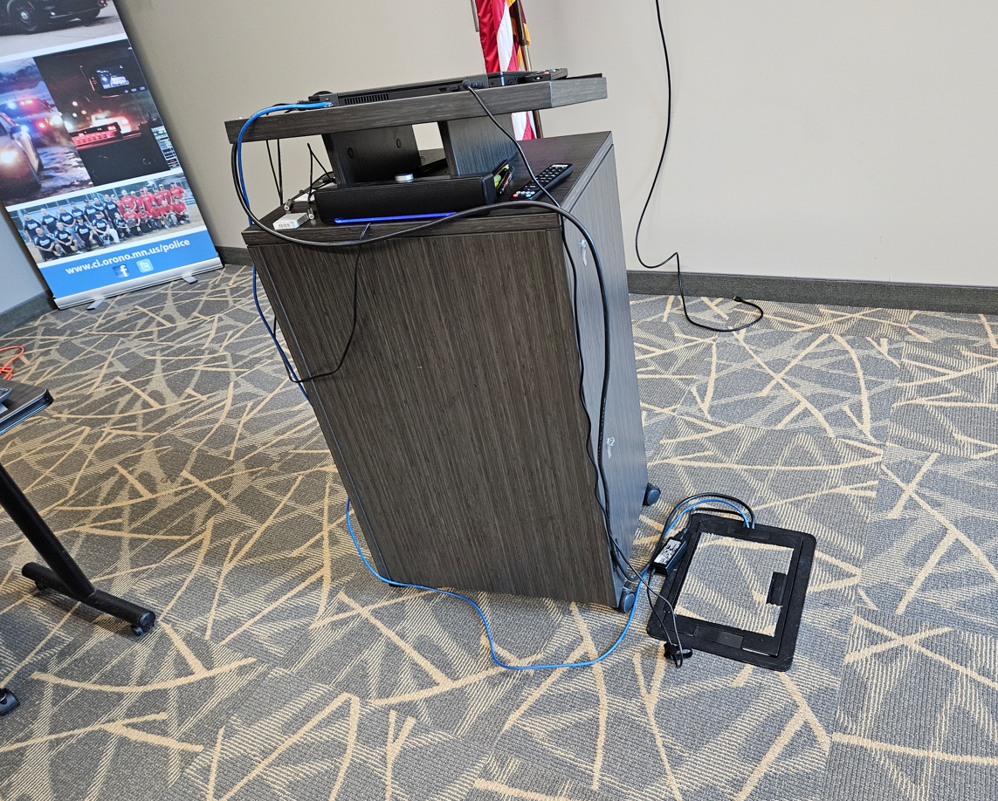
Project: EOC Audio Video Upgrade
CIP Section: IT
Description: Upgrade the Audio Video Equipment in the PD EOC.
Justification: Get better sound and video for training and presentations. The screens are to small and sound now is running off a small sound bar up front, looking to upgrade to a system similar to the Council Chambers
Advantages:
Being able to see what is being presented, looking at a projector for display.
No cables and wires coming out of the floor (Also a safety hazard).
Better Sound throughout the room.
More adaptable for people coming with different presentation devices.
Ensure the safety of our employees and city property.
Look more Professional
Budget Estimate:
Funding: To be funded from Drug/Felony Forfeiture Fund.
Screens Needing Replacement
Item | Estimate
EOC Audio Video Upgrade | $ 50,000
TOTAL | $ 50,000
Cluster of Wires

Slide 7
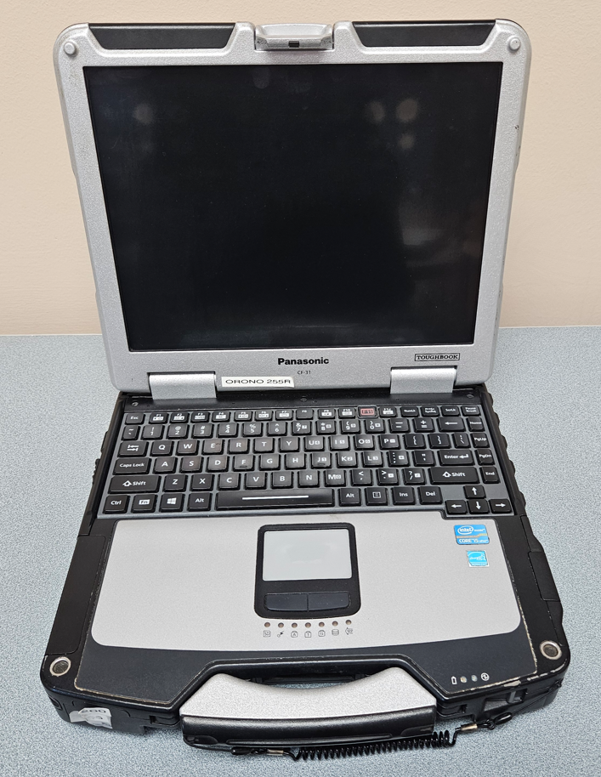
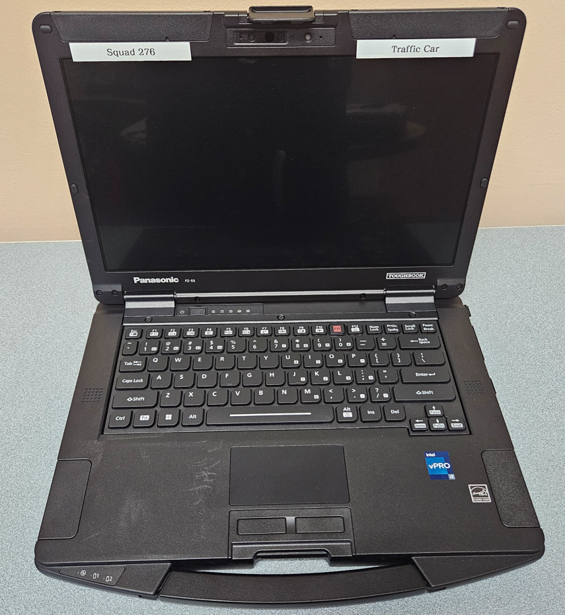
Equipment: MDC Replacement
CIP Section: IT
Description: The replacement of 7 Squad Car MDC’s (Laptops).
Justification: Windows 10 will no longer be supported by October of 2025, which means security updates will no longer be available and could make them more susceptible to viruses and hacks.
Alternatives: Will try update the current ones to Windows 11 if they meet the requirements or take a chance that they won’t be compromised until they can be replaced.
Note: Replacing the MDC’s also require a new docking stations for mounting in the Squad Cars, another added cost.
Budget Estimate:
Funding: To be funded from Drug/Felony Forfeiture Fund.
New MDC
Item | Amount Each | Total
Panasonic FZ-55 Toughbooks | $ 3,500 | $ 24,500
Toughbook FZ-55 Docking Stations | $ 1,000 | $ 7,000
TOTAL |  | $31,500
Old MDC

Slide 8
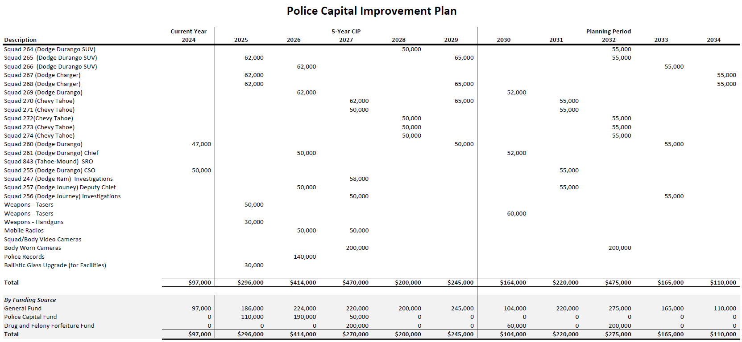

Slide 9
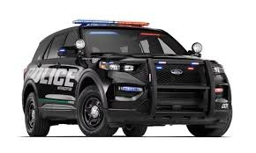
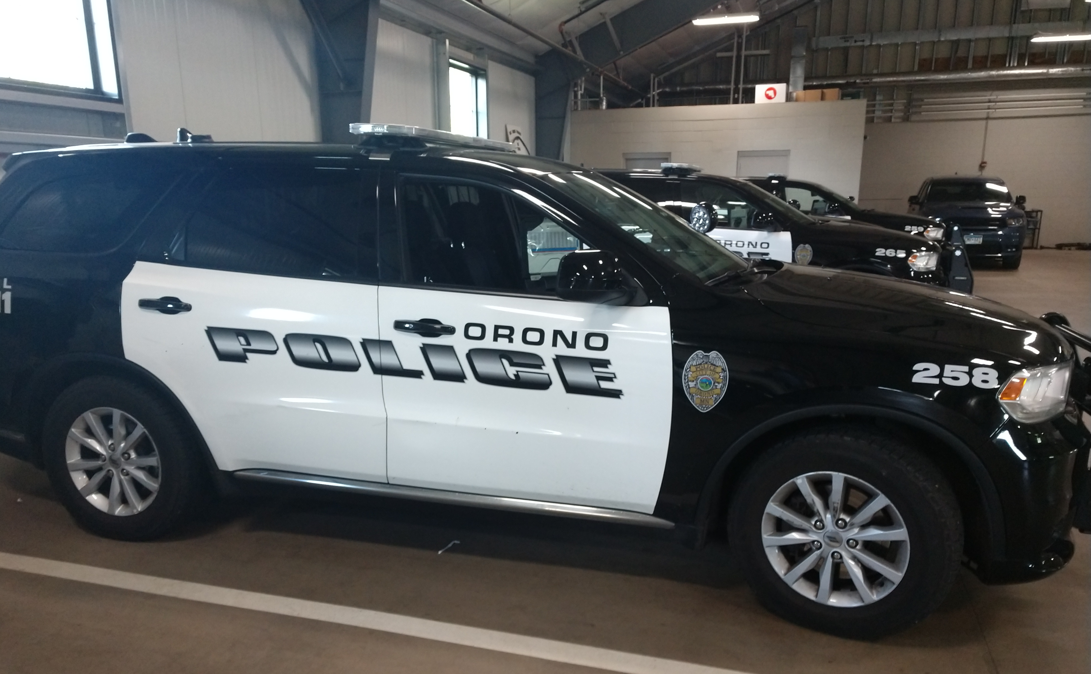
Equipment: Patrol Vehicles
CIP Section: Police
Description: Procure 4 police vehicles.
Justification: 3-4 current police vehicles are in need of replacement. These were purchased in 2019/2020 and will have 95,000+ miles and 1800+ hours of idle time. Vehicle powertrain warranty ends at 100,000 miles.
For a replacement, we propose to purchase similar vehicles to include Chevrolet Tahoe/Dodge Durango or Ford Interceptor.
Alternatives: Do not replace= high maintenance cost to keep running and lower resale value
Budget Estimate:
*General Fund budget includes additional $14,000 for other related expenditures.
Funding:
Expense | Amount Each
Vehicle Purchase | $ 43,000 | $ 129,000
Set Up / Outfitting | $ 19,000 | $ 57,000
Total | $ 62,000 | $ 186,000
Source | Amount
Police Capital Fund | $ 186,000
General Fund | $ 14,000
Total | $ 200,000

Slide 10
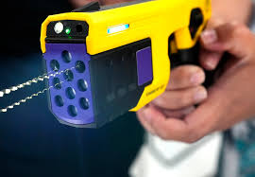
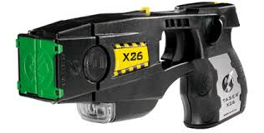
Equipment: Taser Replacement
CIP Section: Police
Description: The replacement of 15 Axon Tasers.
Justification: Our current Tasers are becoming out of date and need to be replaced. This will be a bundled purchase of Tasers, batteries, battery charges, training cartridges and a five year warranty on these items items
Alternatives: Replacing them individual when needed and a substantially higher cost per unit and the bundled price includes yearly training cartridges which currently cost $40 per cartridge.
Note: This is only estimated as we have just begun the process and the price and quantity of Taser 10’s may change.
Budget Estimate:
Funding: To be funded from Drug/Felony Forfeiture Fund.
New Taser 10
Item | Amount Each | Total
Taser 10 Bundle for 15 units | TBD | $50,000
TOTAL |  | $50,000
Old Taser X26

Slide 11
Equipment: Ballistic Glass Upgrade
CIP Section: Police
Description: To be discussed at work session
Justification: Officer safety and protective feature.
Alternatives: Confidential will discuss at work session
Budget Estimate:
Funding: To be funded from Drug/Felony Forfeiture Fund.
Item | Total
Ballistic Film Upgrade | $ 28,000
TOTAL | $ 28,000

Slide 12
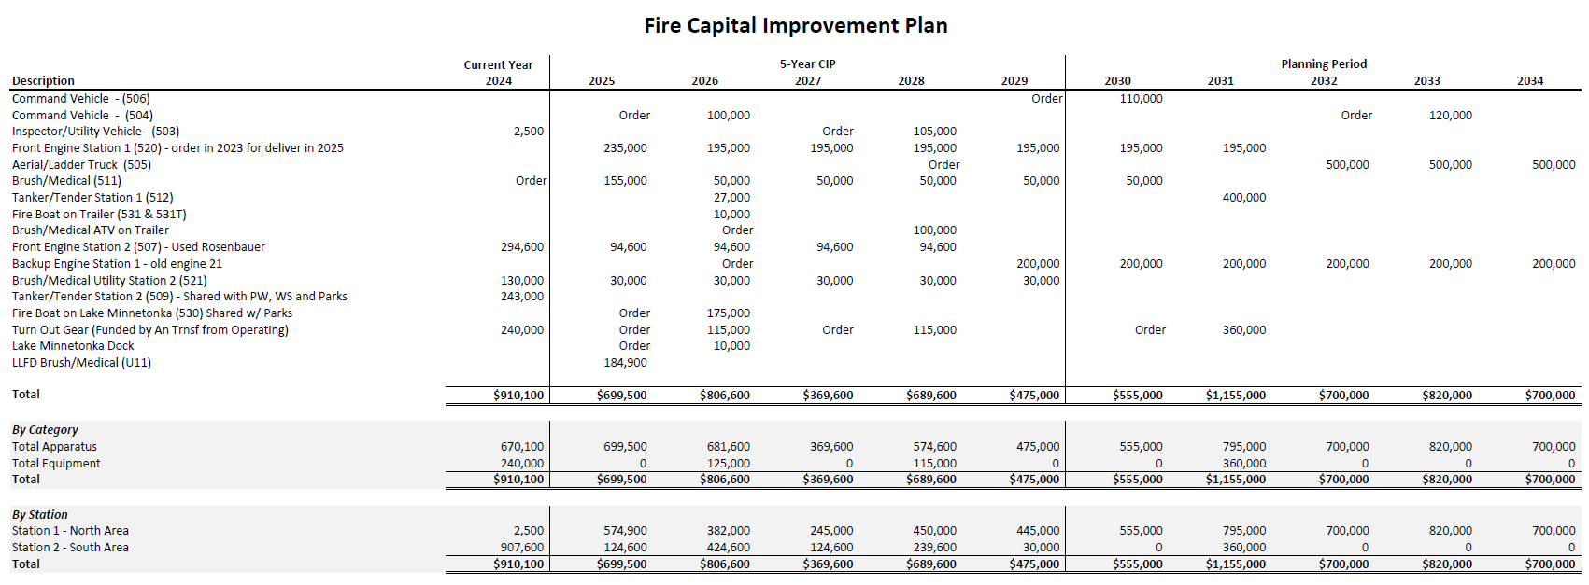

Slide 13
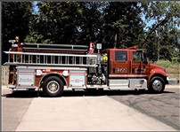
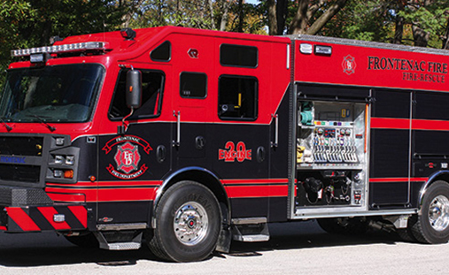
Equipment: Front Engine Rescue Pumper
CIP Section: Fire
Description: Procure new rescue pumper (Unit 520).
Justification: NFPA states that a front out pumper should be under 15 years old and should be retired at 25 years old. Current pumpers are over 20 years old. These were purchased in 2003/2004 (see picture). The new rescue pumper would look like the bottom picture. The lead time on a Rescue Pumper is over 2 years. There is a discount for ordering 2 at the same time. We are able to spread the payments over a set number of years. Orono owns 100% of Engine 21 and 74.68% of Engine 11.
For a replacement we propose to purchase similar vehicles to Long Lake Fire’s current rescue pumper but with an updates.
Alternatives: Do not replace= high maintenance cost to keep running, out of compliance with NFPA, and lower resale value.
Budget Estimate:
Funding:
Expense | Amount
Vehicle Purchase | $ 1,203,645
Set Up / Outfitting | $ 201,355
TOTAL | $ 1,405,000
Source | Amount
Fire Capital Fund | $ 1,405,000

Slide 14
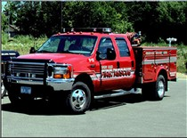
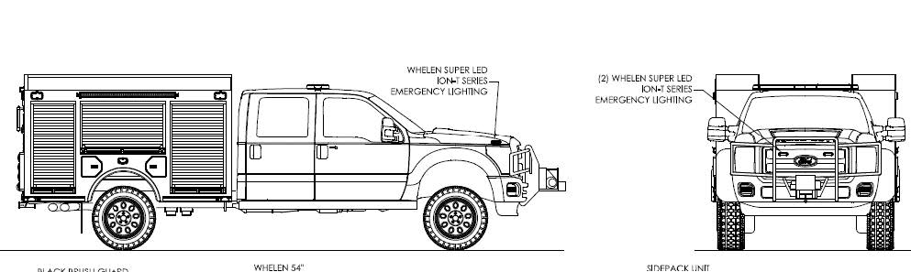
Equipment: Brush-Medical Response Utility
CIP Section: Fire
Description: Procure a new Brush-Medical Response Utility. This will be a duplicate of the Brush-Medical Response Utility ordered in 2023.
Justification: This vehicle is needed to respond to brush fire and medicals along with other calls. It is the most widely used vehicle in the fleet. We need to have one at each fire station for response.
For a replacement we propose to purchase similar vehicles to the current Utility 11 (see picture) and the Brush-Medical Response Utility already purchased.
Alternatives: Do not replace= responding to calls in a large rescue pumper, which is harder to maneuver and can not get to the brush fires.
Budget Estimate:
Funding:
Expense | Amount
Vehicle Purchase | $ 254,311
Set Up / Outfitting | $ 150,689
TOTAL | $ 405,000
Source | Amount
Fire Capital Fund | $ 405,000

Slide 15
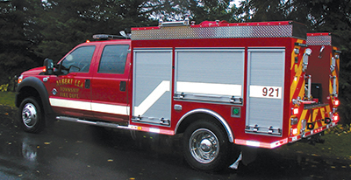
Equipment: Brush-Medical Response Utility for LLFD
CIP Section: Fire
Description: Provide short term funding for LLFD to procure a new Brush-Medical Response Utility.
Justification: This vehicle is used to respond to brush fire and medicals along with other calls. It is the most widely used vehicle in the fleet.
Discussion: Long Lake added this vehicles to the CIP for purchase in 2025. In light of the contract ending at the end of 2025, the Long Lake council has agreed to guarantee the buy out of Orono’s portion of the purchase at the end of the contract. Orono’s LLFD FAB members indicated Orono would be amenable to this arrangement.
Budget Estimate:
Funding:
Expense | Amount
Vehicle Purchase | $ 240,000
Orono Portion | $ 184,900
Long Lake Portion | $ 33,262
Medina Portion | $ 21,836
Source | Amount
Fire Capital Fund | $184,900
Notes:
Council member Dyvik reported that at the last Fire Advisory Board meeting, the Board had discussed inclusion of the utility/rescue truck on the CIP. They had communicated with the Board that it had been a need for a number of years, the vehicle had already been ordered, and they had asked if all three cities would participate in that purchase per the contract terms. Orono had indicated that they would participate if the City would commit to buying the vehicle back at the end of the contract. A motion was made by Dyvik, seconded by Miner, to communicate to the City of Orono that Long Lake would buy the utility/rescue truck outright at the end of the current fire services agreement/contract. Ayes: all.

Slide 16
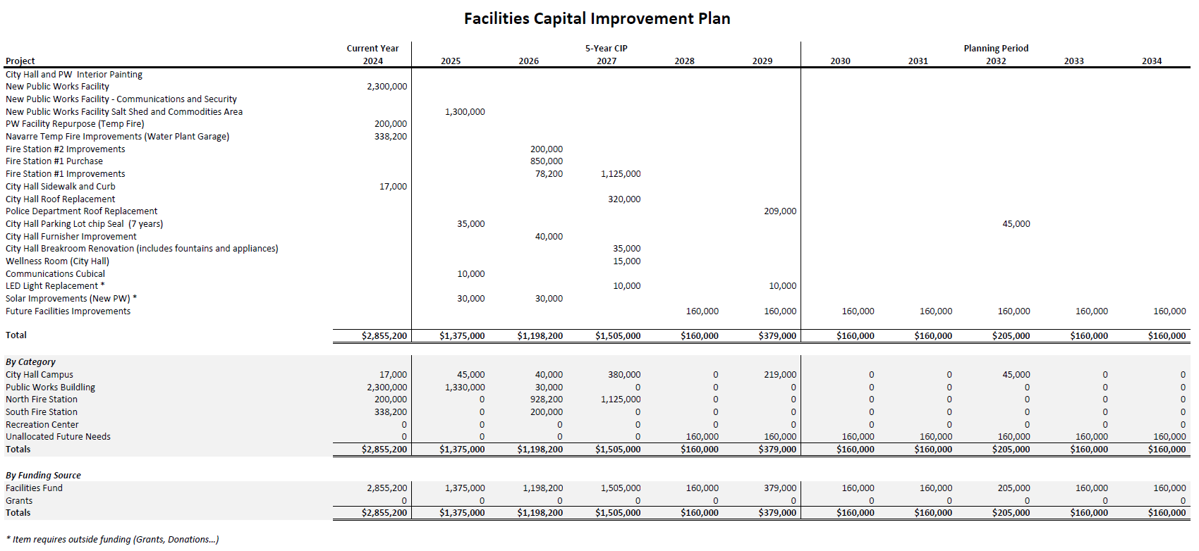

Slide 17
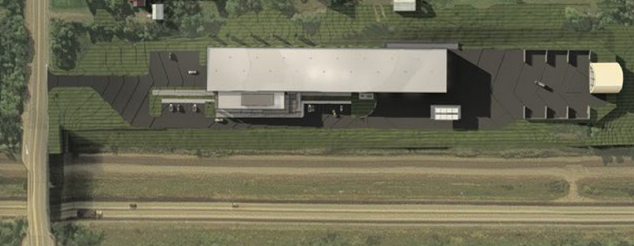
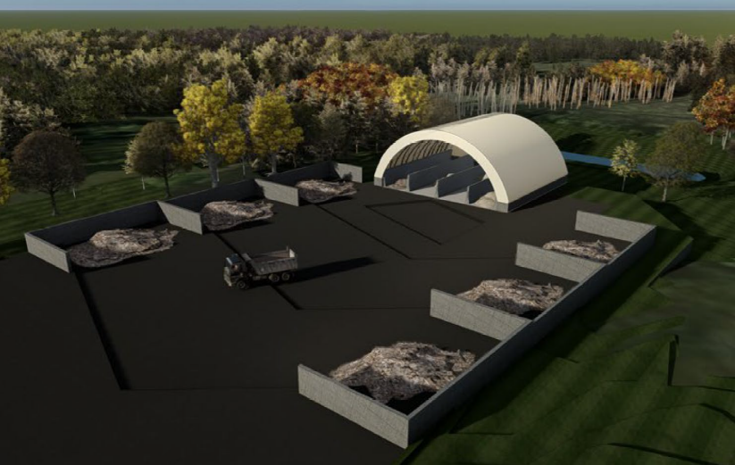
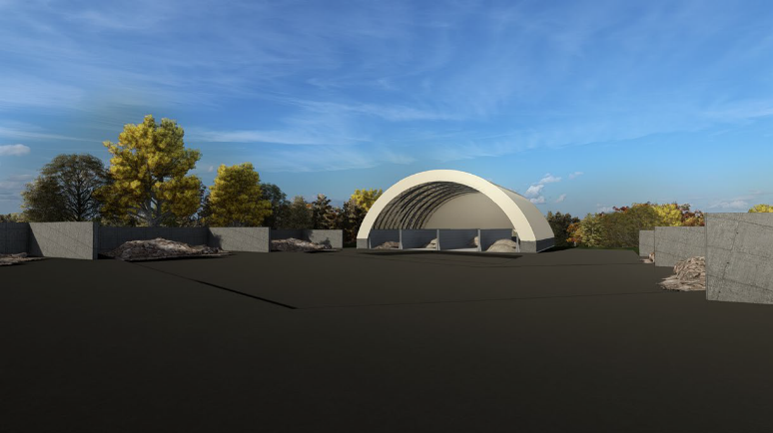
New Public Works Facility -
Salt Shed and Commodities Area
CIP Section: Facilities
Project Scope / Description: Plan to construct a salt and commodity area west of the new public works building.
Analysis of Need / Justification: Improved efficiencies with commodities and salt access closer to operating facility.
Alternatives: Continue to use existing site.
Budget Estimate:
Funding: Project is funded by the Facilities Fund.
Location: West of New Public Works Facility
Item | Amount
Entire Project | $ 1,300,000
TOTAL | $ 1,300,000
Notes:
Council member Dyvik reported that at the last Fire Advisory Board meeting, the Board had discussed inclusion of the utility/rescue truck on the CIP. They had communicated with the Board that it had been a need for a number of years, the vehicle had already been ordered, and they had asked if all three cities would participate in that purchase per the contract terms. Orono had indicated that they would participate if the City would commit to buying the vehicle back at the end of the contract. A motion was made by Dyvik, seconded by Miner, to communicate to the City of Orono that Long Lake would buy the utility/rescue truck outright at the end of the current fire services agreement/contract. Ayes: all.

Slide 18
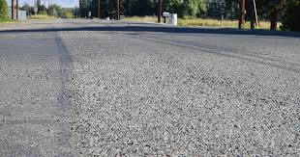
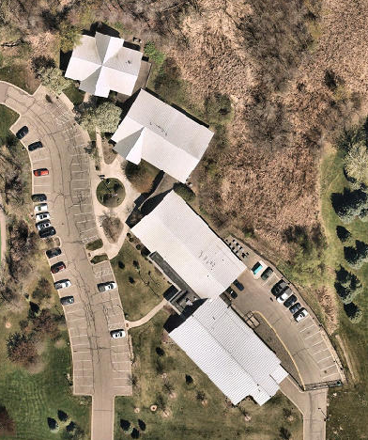
City Hall Parking Lot (Chip Seal)
CIP Section: Facilities
Project Scope / Description: A scheduled maintenance every 7 years to maintain the quality and appearance of parking lot.
Analysis of Need / Justification: Deteriorating and aging asphalt needs some reinforcement to extend its life and improve appearance.
Alternatives: Increased cost down the road. Mill and pave lot.
Budget Estimate:
Funding: Project is funded by the Facilities Fund.
Location: City Hall
Item | Amount
Chip Seal | $ 35,000
TOTAL | $ 35,000
Notes:
Council member Dyvik reported that at the last Fire Advisory Board meeting, the Board had discussed inclusion of the utility/rescue truck on the CIP. They had communicated with the Board that it had been a need for a number of years, the vehicle had already been ordered, and they had asked if all three cities would participate in that purchase per the contract terms. Orono had indicated that they would participate if the City would commit to buying the vehicle back at the end of the contract. A motion was made by Dyvik, seconded by Miner, to communicate to the City of Orono that Long Lake would buy the utility/rescue truck outright at the end of the current fire services agreement/contract. Ayes: all.

Slide 19
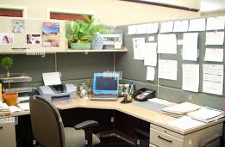
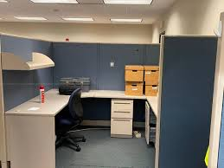
Communication Cubical
CIP Section: Facilities
Project Scope / Description: Creating a workspace for the Communications personnel.
Analysis of Need / Justification: Create an area for the Communications personnel to work out of in City Hall.
Alternatives: Find alternative seating arrangement for the staff that may have less workspace and less efficiency.
Budget Estimate:
Funding: Project is funded by the Facilities Fund.
Location: City Hall
Item | Amount
Cubicle | $ 10,000
TOTAL | $ 10,000
Notes:
Council member Dyvik reported that at the last Fire Advisory Board meeting, the Board had discussed inclusion of the utility/rescue truck on the CIP. They had communicated with the Board that it had been a need for a number of years, the vehicle had already been ordered, and they had asked if all three cities would participate in that purchase per the contract terms. Orono had indicated that they would participate if the City would commit to buying the vehicle back at the end of the contract. A motion was made by Dyvik, seconded by Miner, to communicate to the City of Orono that Long Lake would buy the utility/rescue truck outright at the end of the current fire services agreement/contract. Ayes: all.

Slide 20
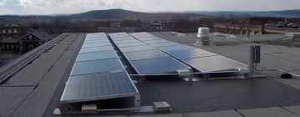
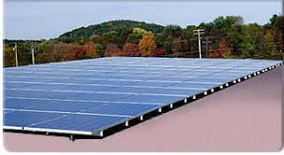
Solar Improvements (New PW)
CIP Section: Facilities
Project Scope / Description: Implementation of Solar panels on rooftop of Public Works building.
Analysis of Need / Justification: Ability to reduce energy costs and benefit from state and federal grant opportunities. Introduction of green energy to City facilities.
Alternatives: Continue to operate as is and pay electrical utility rates set by the utility company.
Budget Estimate:
Funding: Project is funded by the Facilities Fund.
Location: Public Works Building
Item | Amount
Solar Panels | $ 30,000
TOTAL | $ 30,000
Notes:
Council member Dyvik reported that at the last Fire Advisory Board meeting, the Board had discussed inclusion of the utility/rescue truck on the CIP. They had communicated with the Board that it had been a need for a number of years, the vehicle had already been ordered, and they had asked if all three cities would participate in that purchase per the contract terms. Orono had indicated that they would participate if the City would commit to buying the vehicle back at the end of the contract. A motion was made by Dyvik, seconded by Miner, to communicate to the City of Orono that Long Lake would buy the utility/rescue truck outright at the end of the current fire services agreement/contract. Ayes: all.

