Slide 1

17-3944
2520 Shadywood Road
RPUD and Master Plan

Slide 2
Basics
40 unit condominium building
RPUD zoning (allows for flexibility)
Parking for 84 cars (51 in lowest level)
Access off of Shadywood, lines up with the church.

Slide 3
Zoning
Density slightly higher than prescribed (15.63/ 15)
Hardcover, FAR, structural cover will meet
Landscaping/ screening not yet provided

Slide 4
Main Issues
Height. 30 foot maximum (proposes 48’8”)
Traffic. Major concern of neighborhood.
ITE Trip Generation |  |  | 9th edition
 |  | Daily | AM | PM
40 Unit Apartment |  | 266 | 20 | 25
40 unit Condominium |  | 232 | 18 | 21
20,000 sqft office |  | 386 | 53 | 101
20,000 sqft retail |  | 2386 | 58 | 204
15,000 sqft restaurant |  | 1349 | 12 | 112

Slide 5
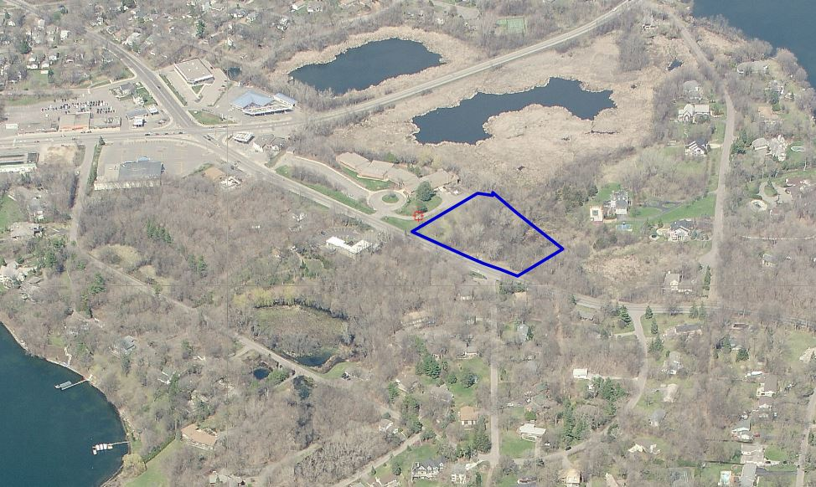

Slide 6
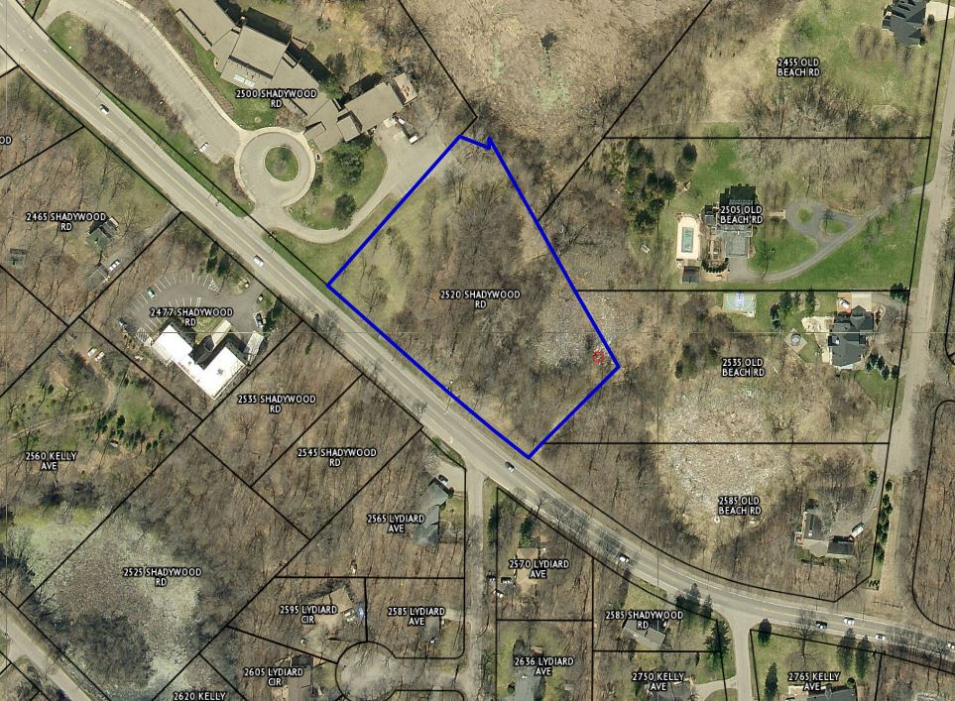

Slide 7
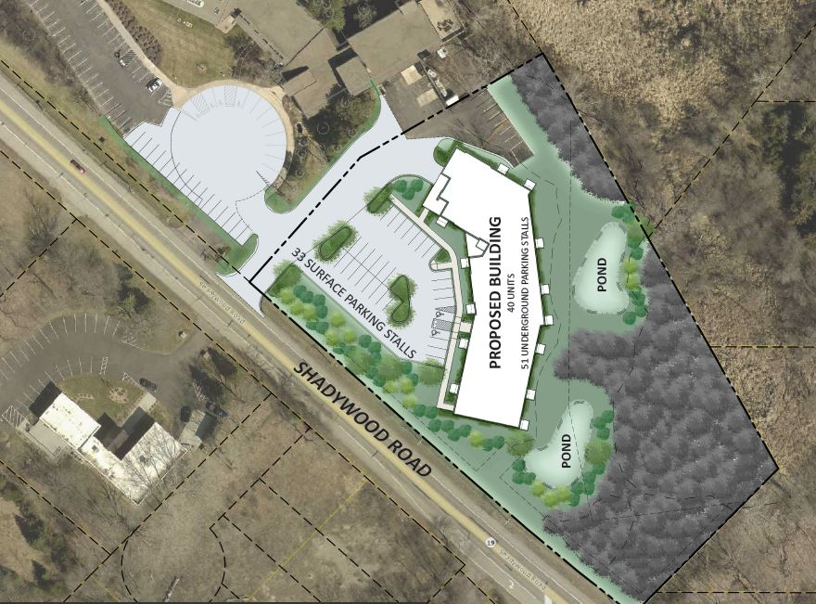

Slide 8
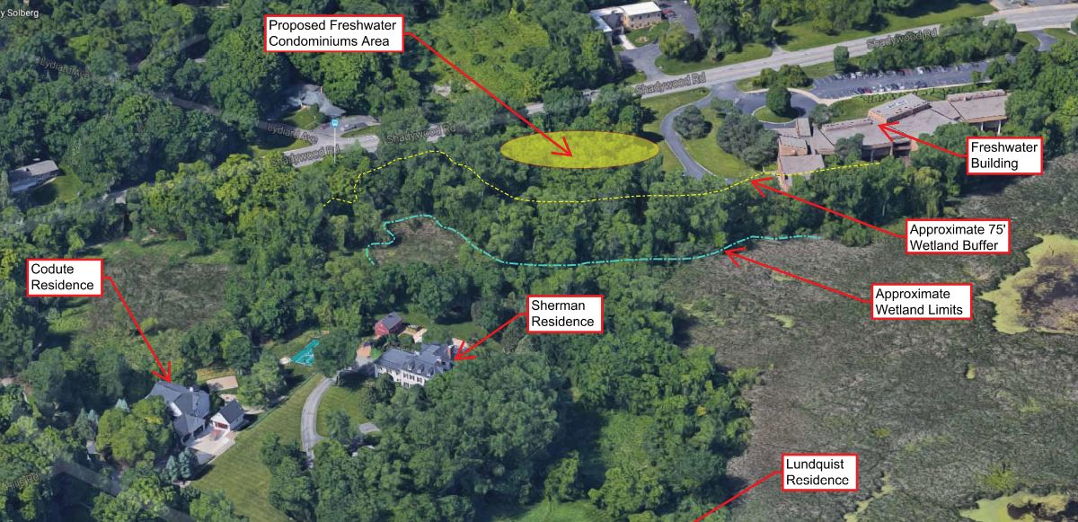

Slide 9
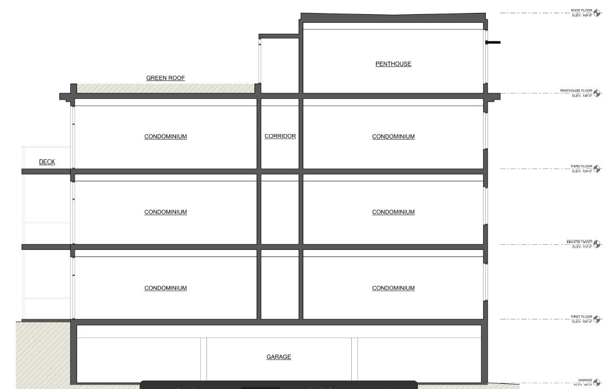

Slide 10
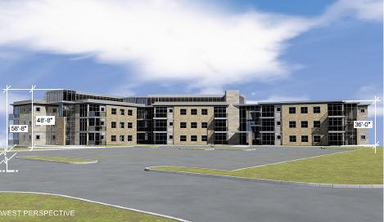

Slide 11
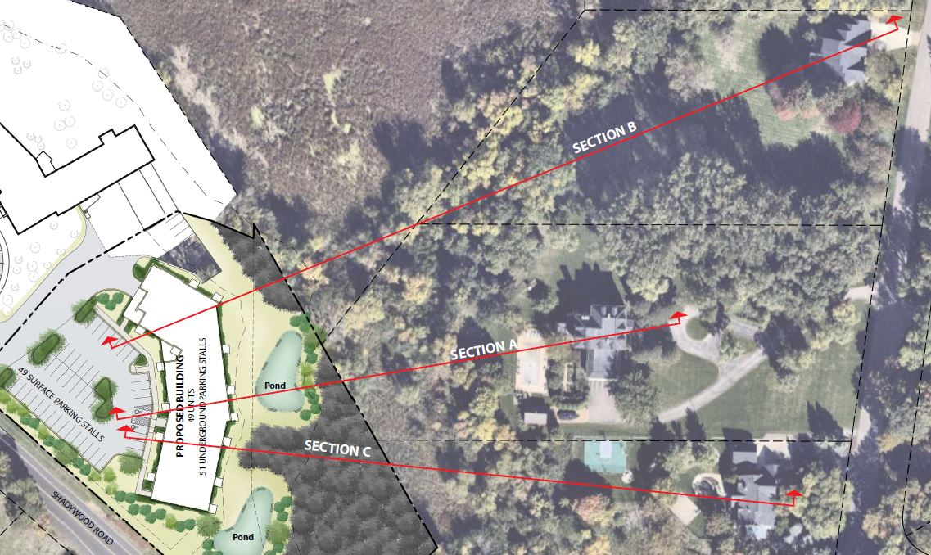

Slide 12
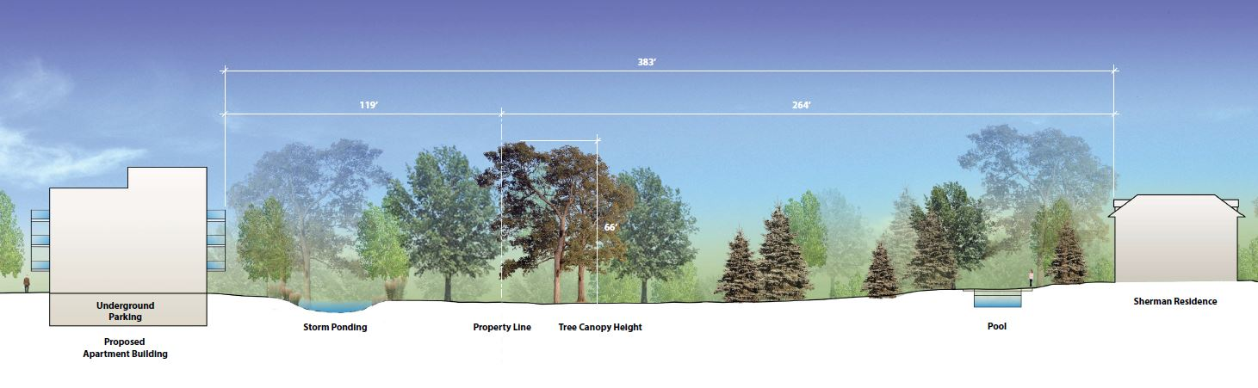
Sherman (A)

Slide 13
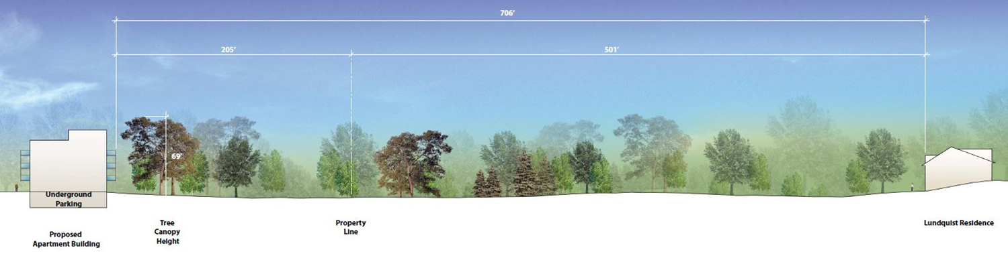
Lundquist (B)

Slide 14
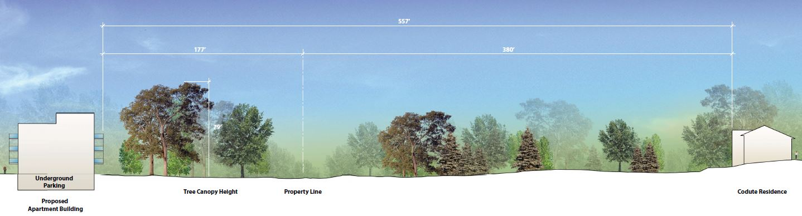
Codute (C)

Slide 15
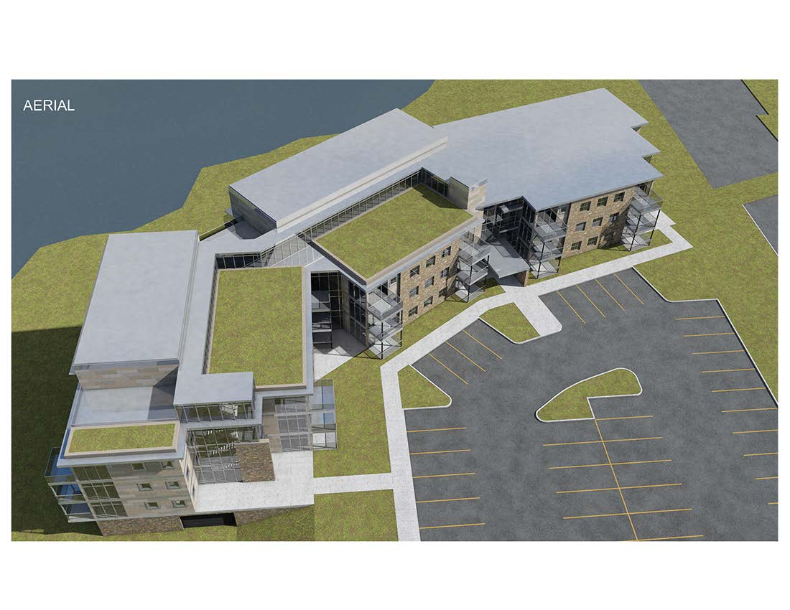

Slide 16
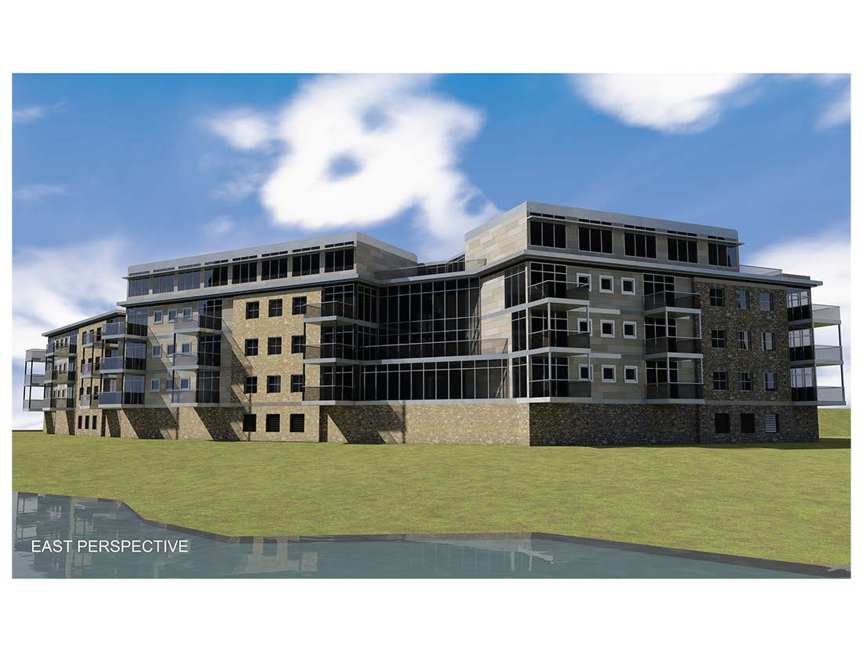

Slide 17
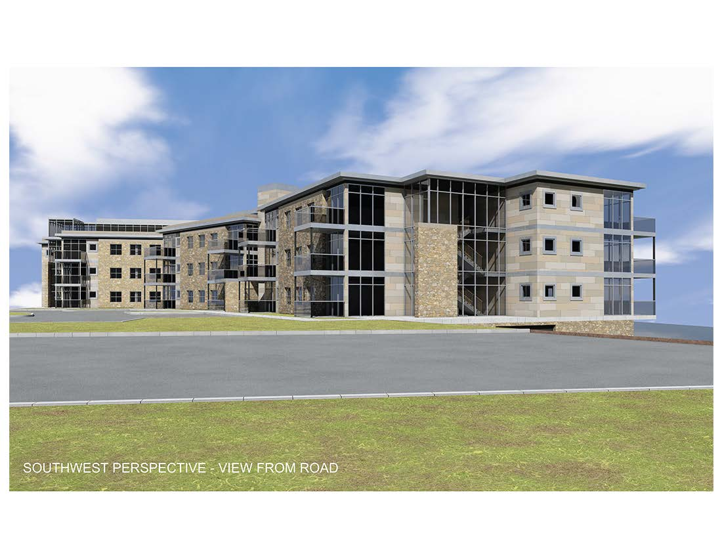

Slide 18
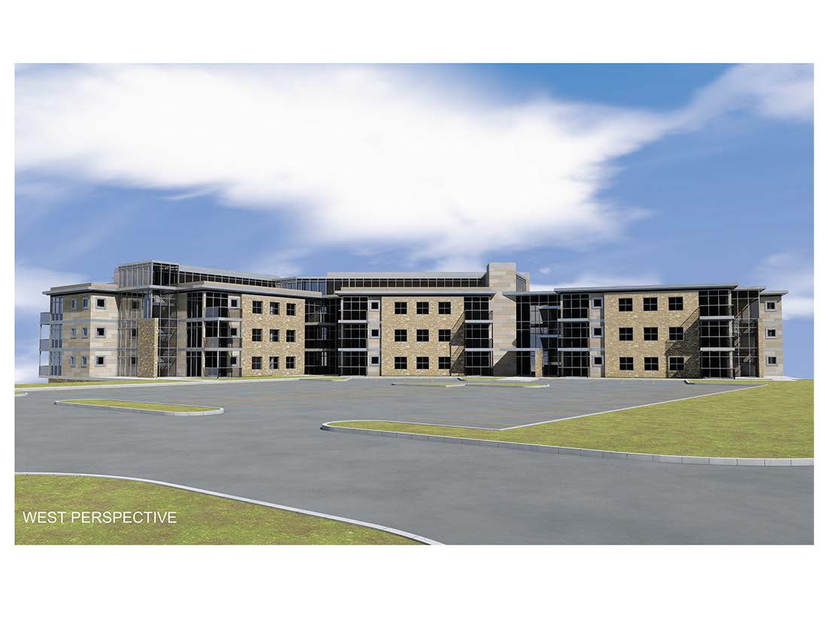

Slide 19
Zoning
Staff recommends tabling, allowing for items identified to be addressed
Applicant desires a recommendation, to be received by City Council on July 10th.

